Slide 1
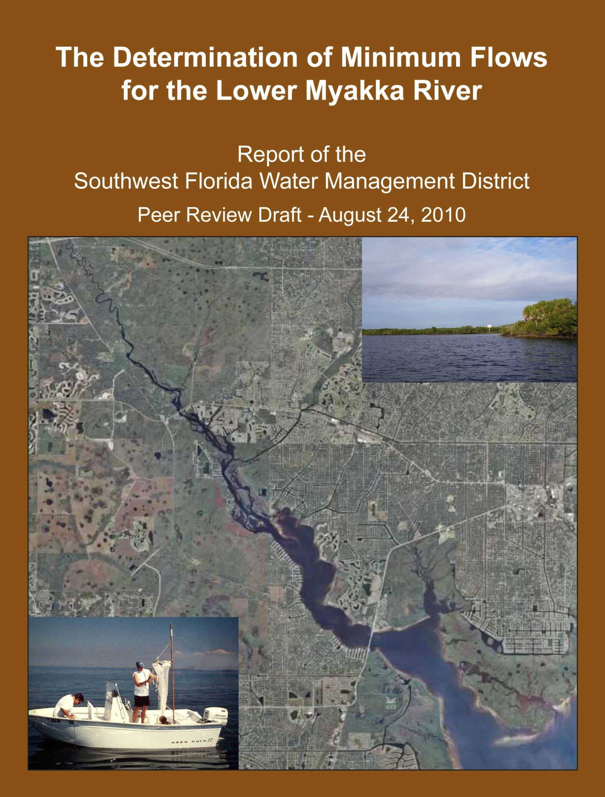

Slide 2
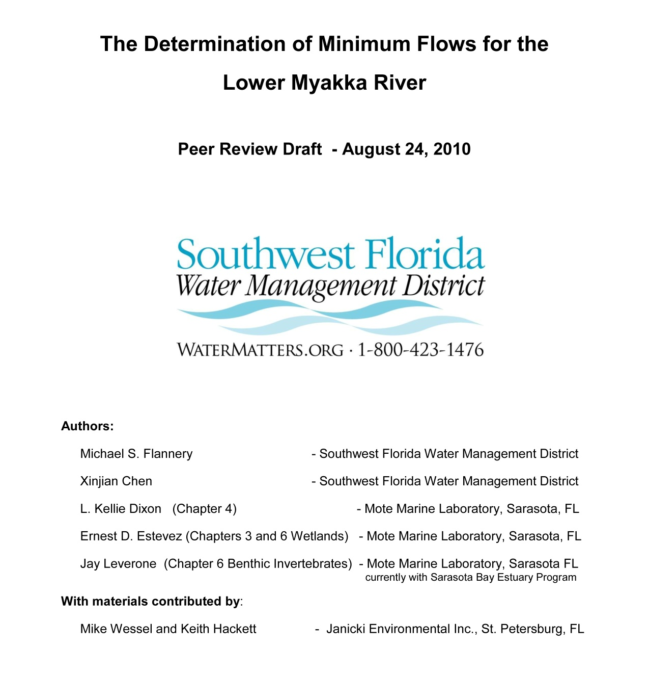

Slide 3
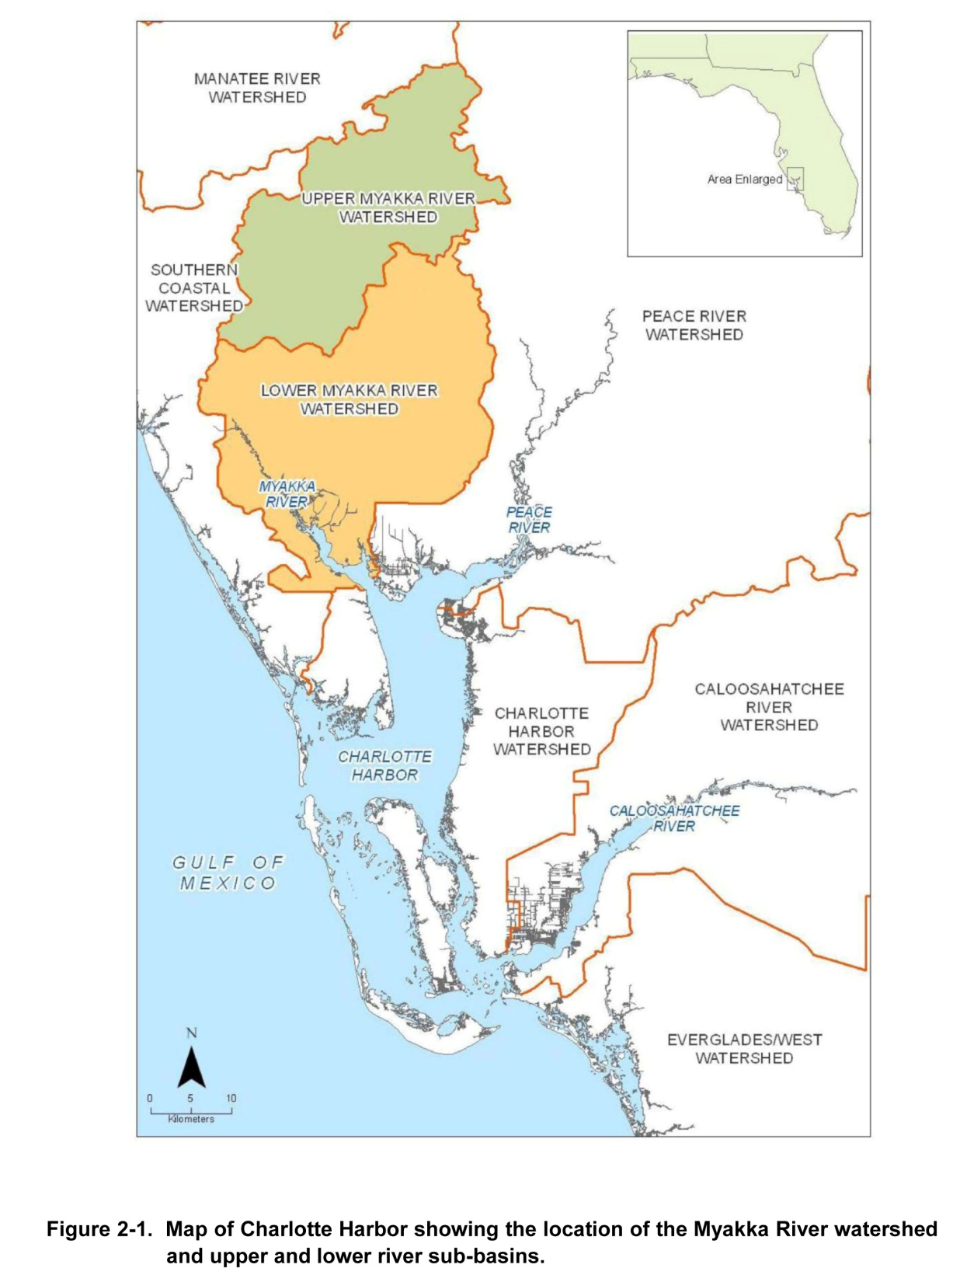
Myakka River – Upper and Lower River Sub-basins

Slide 4
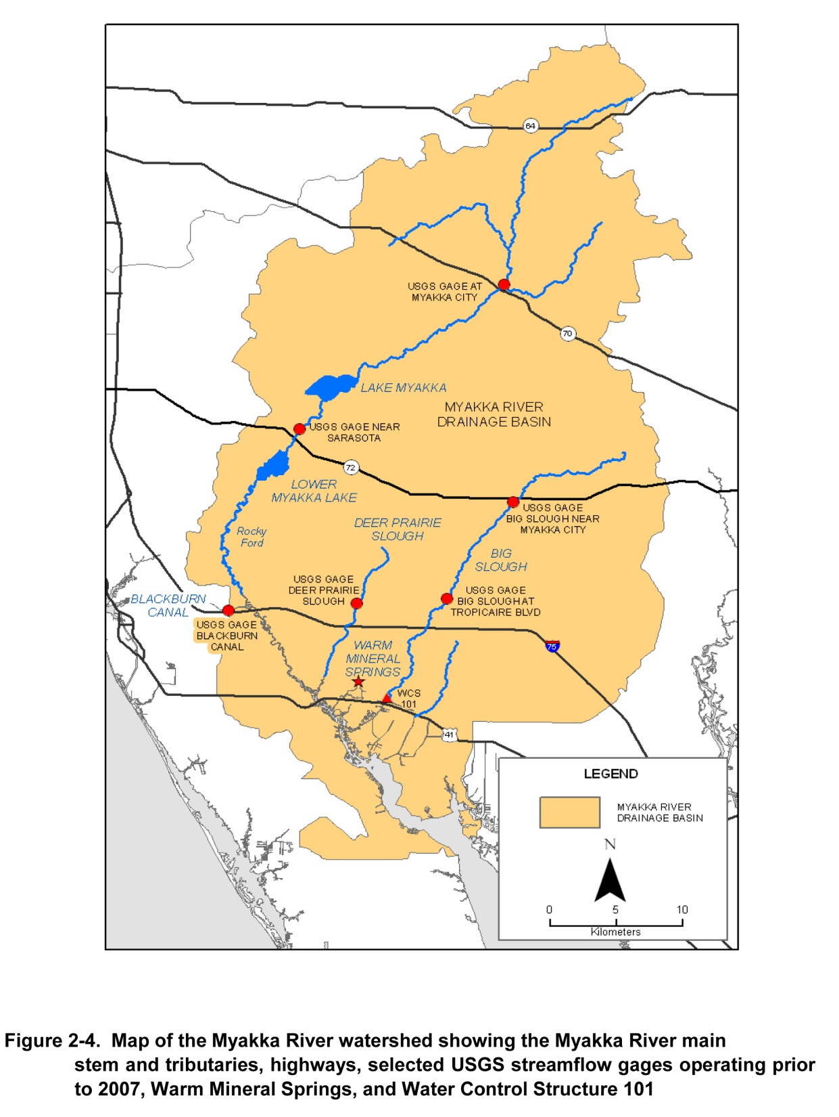
Major Streamflow Gages – Myakka River Watershed Circled - Myakka River near Sarasota
- Myakkahatchee Creek

Slide 5
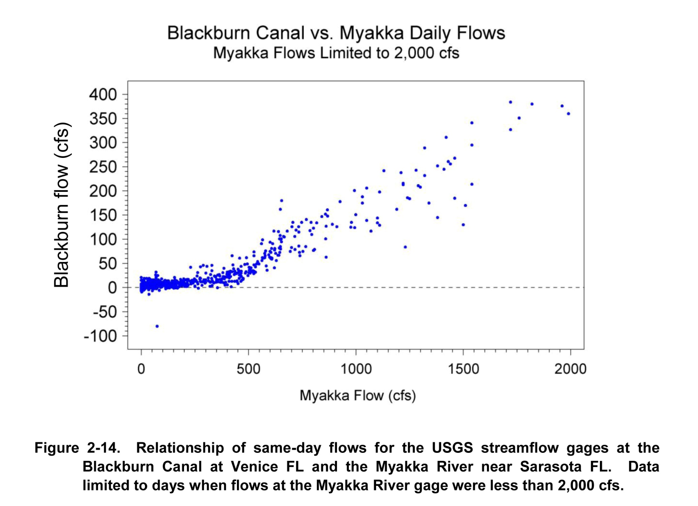

Slide 6
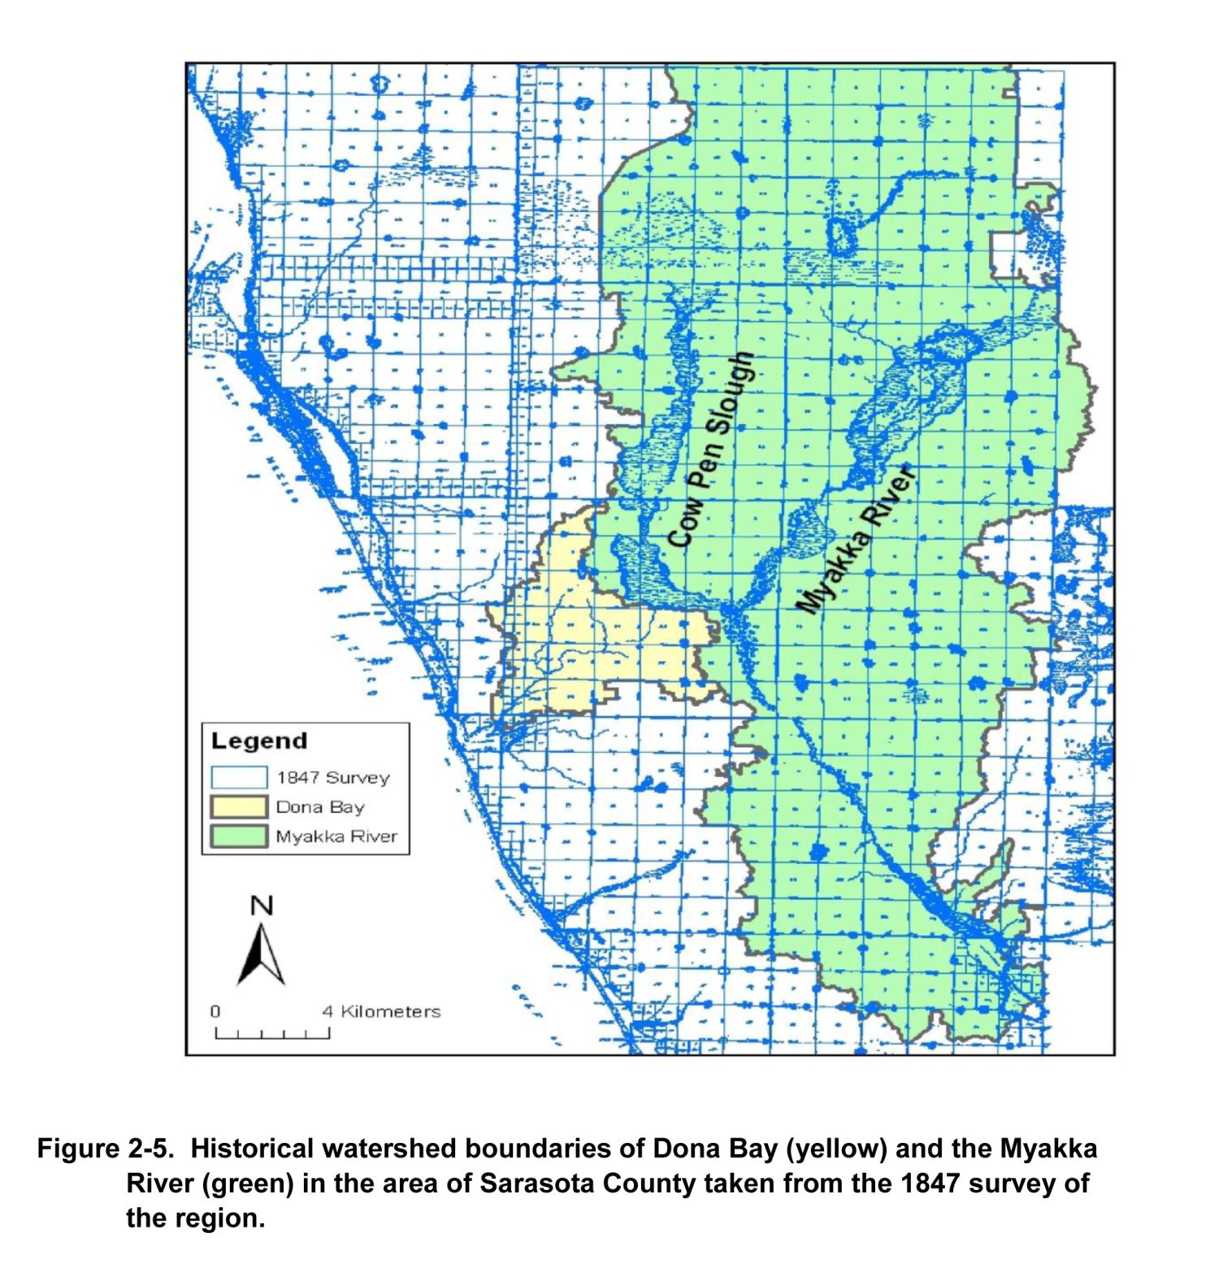

Slide 7
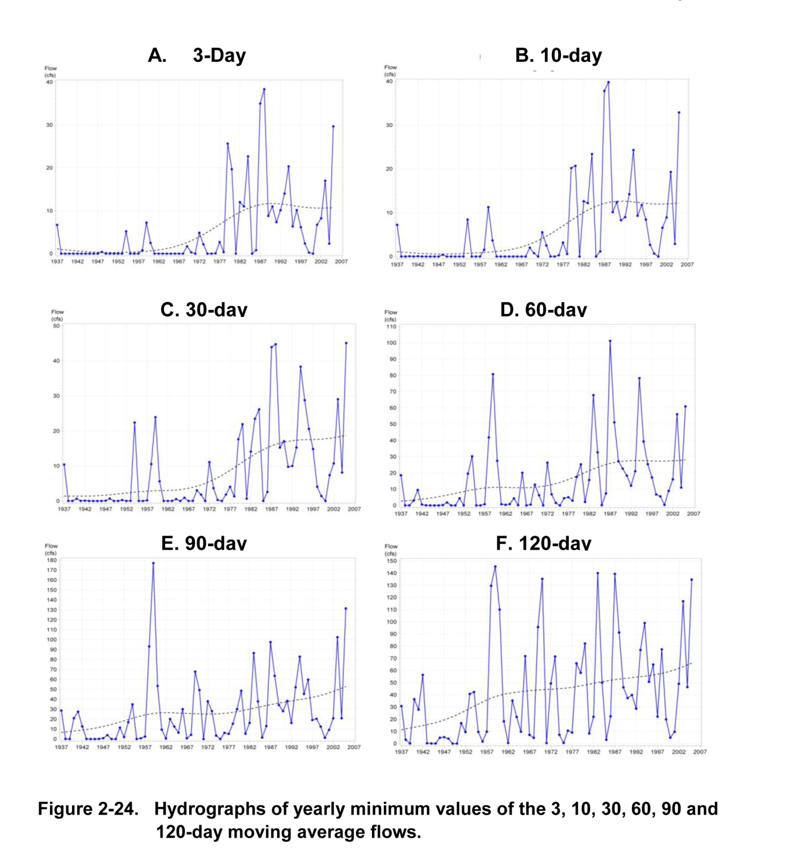

Slide 8
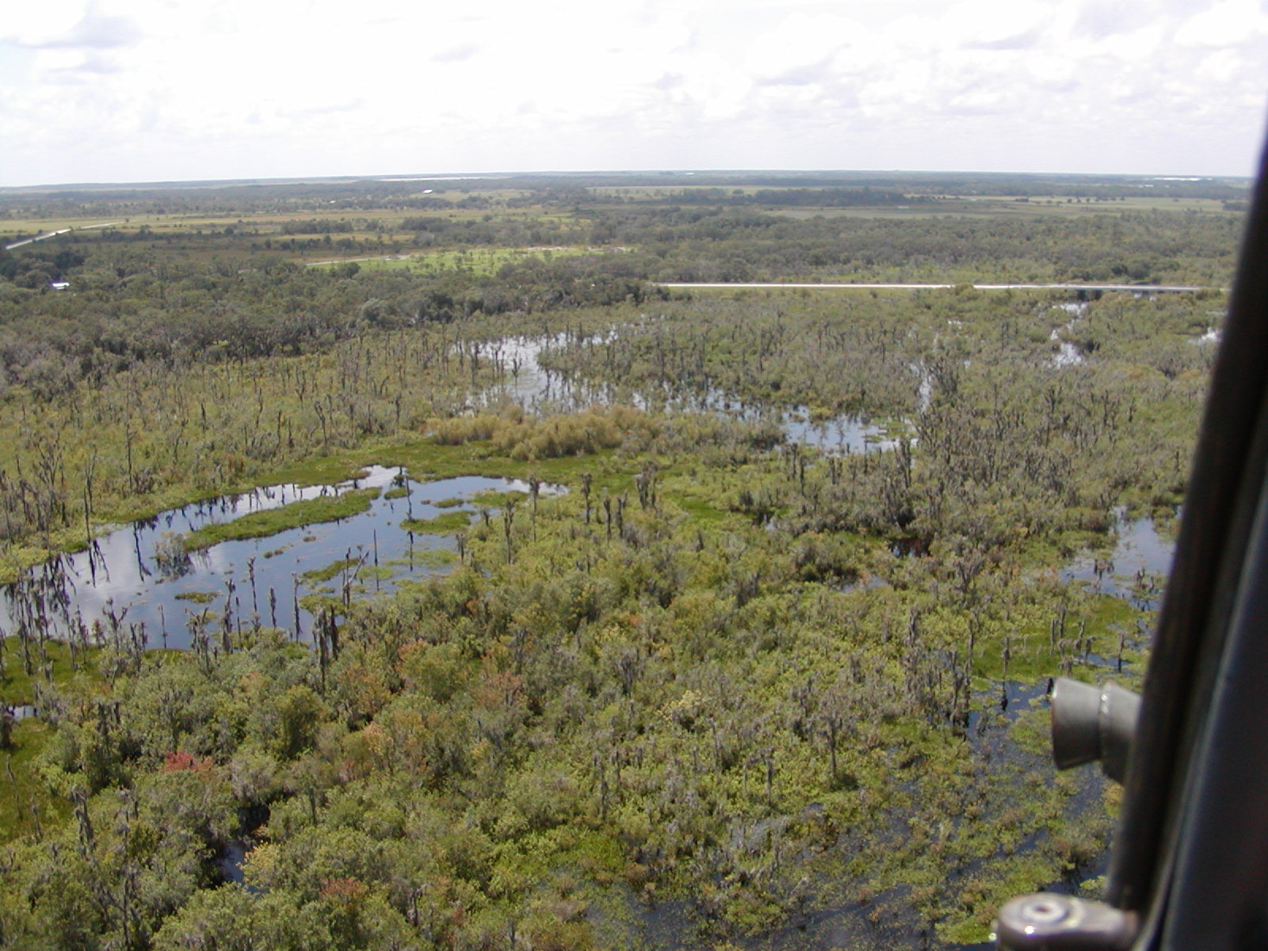

Slide 9
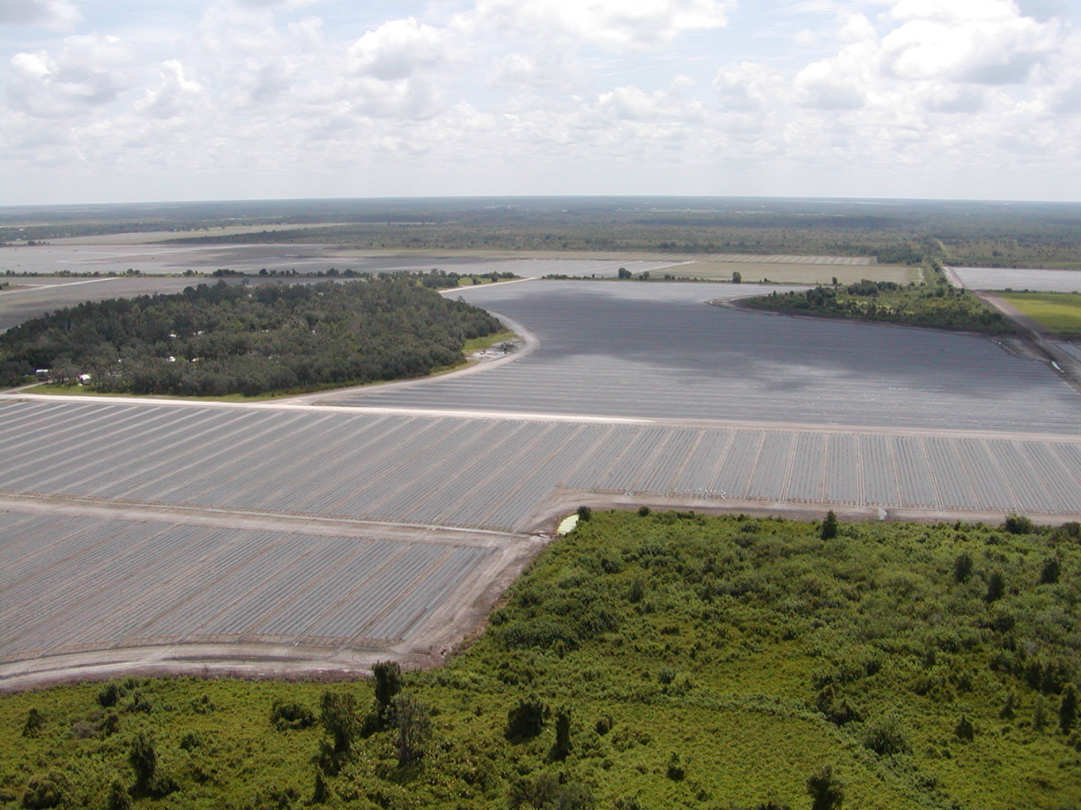

Slide 10
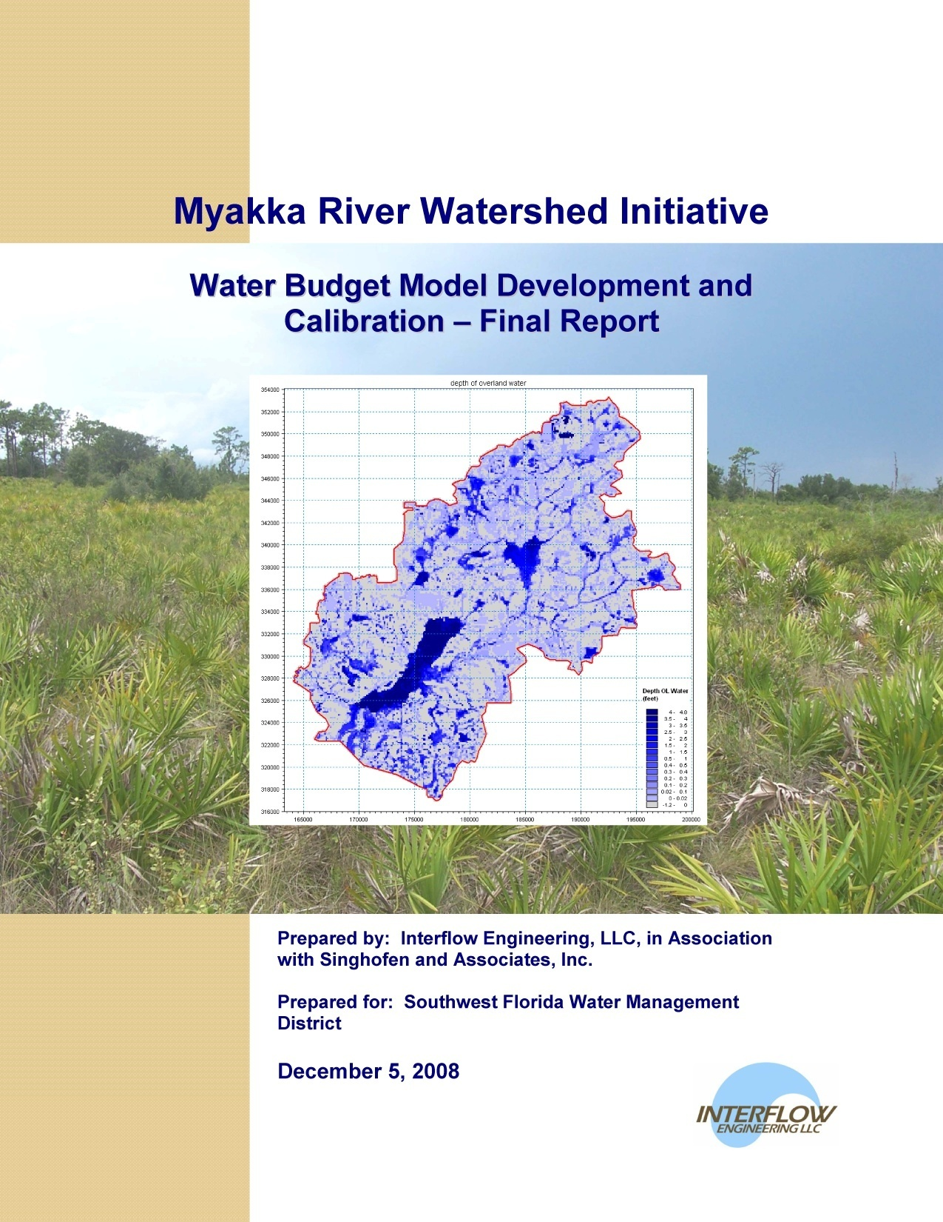

Slide 11
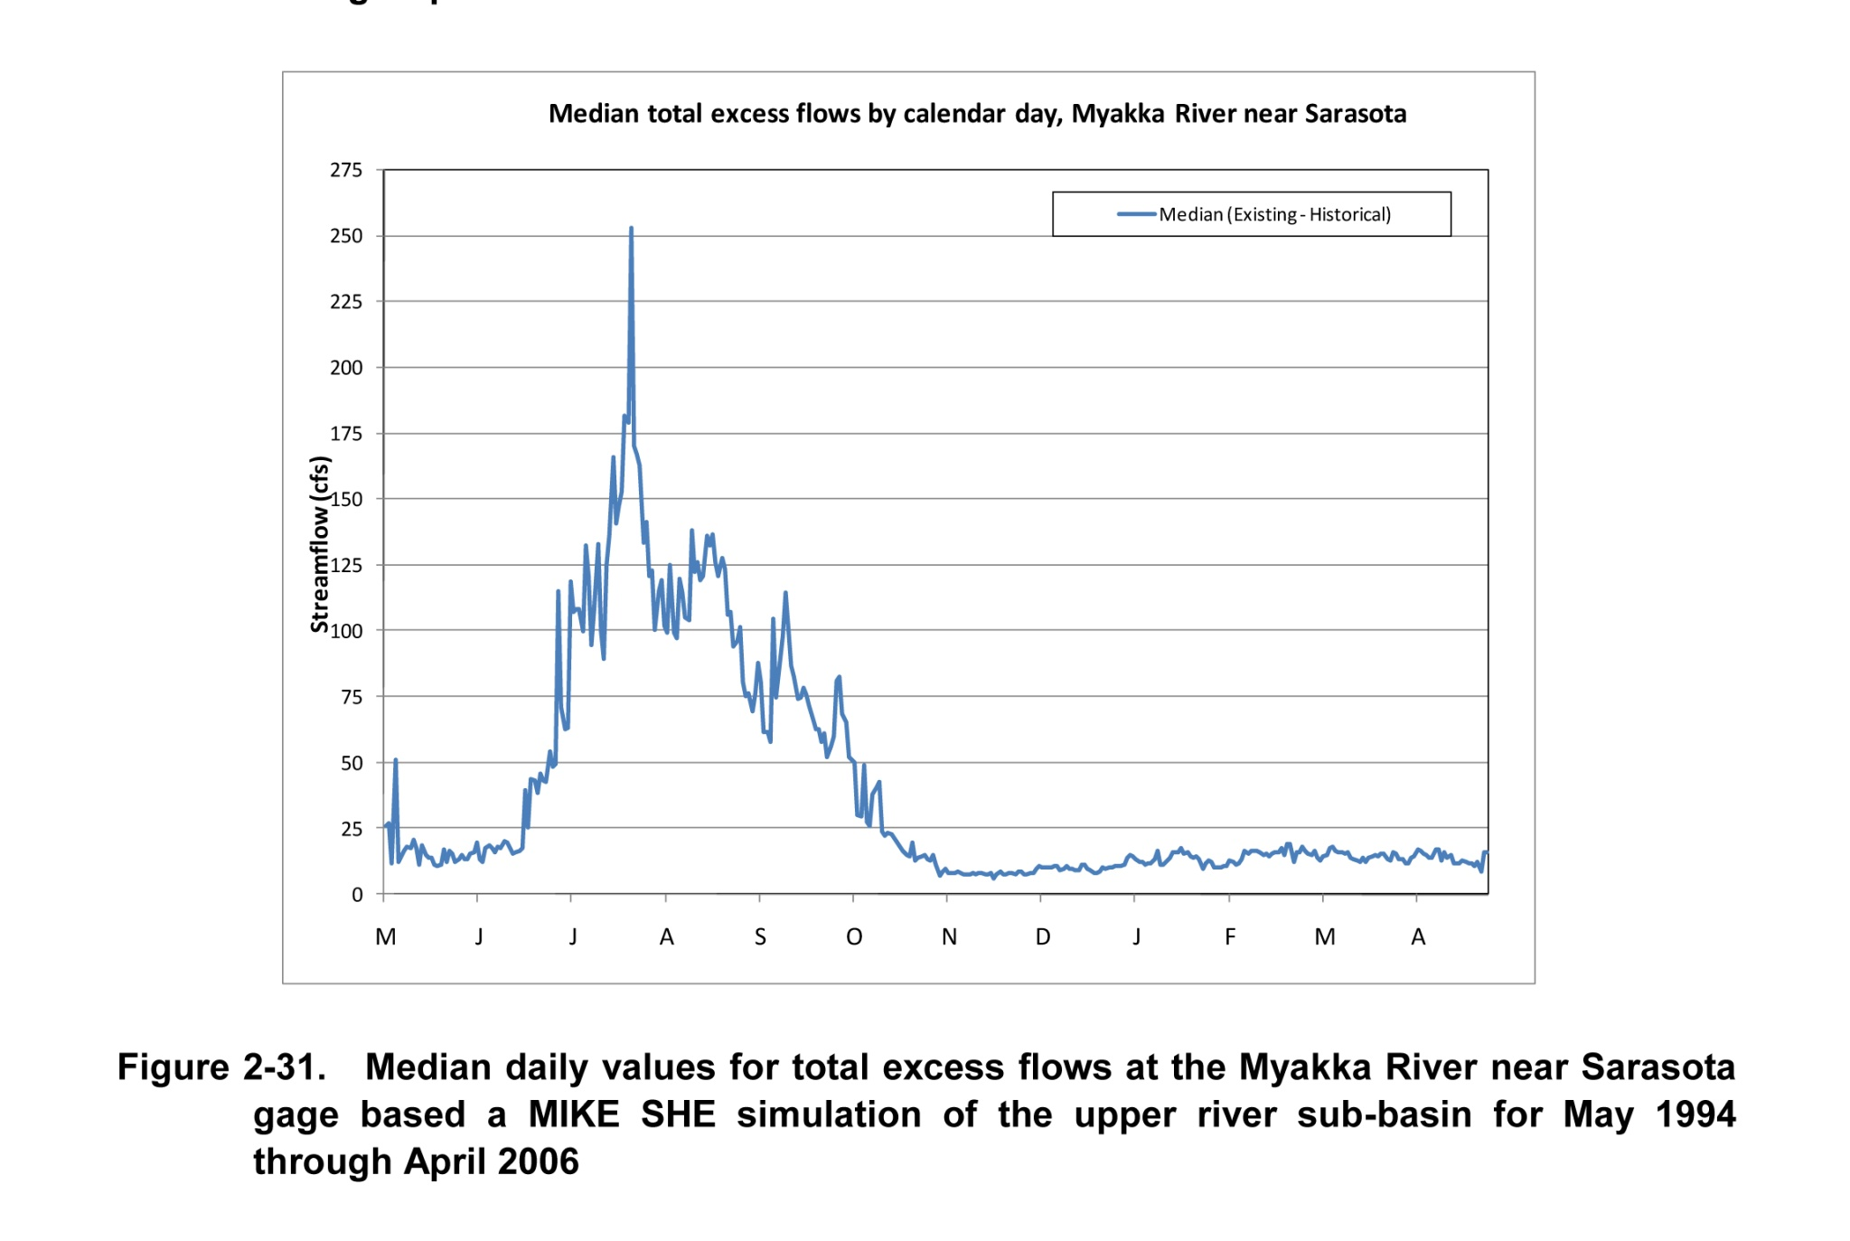

Slide 12
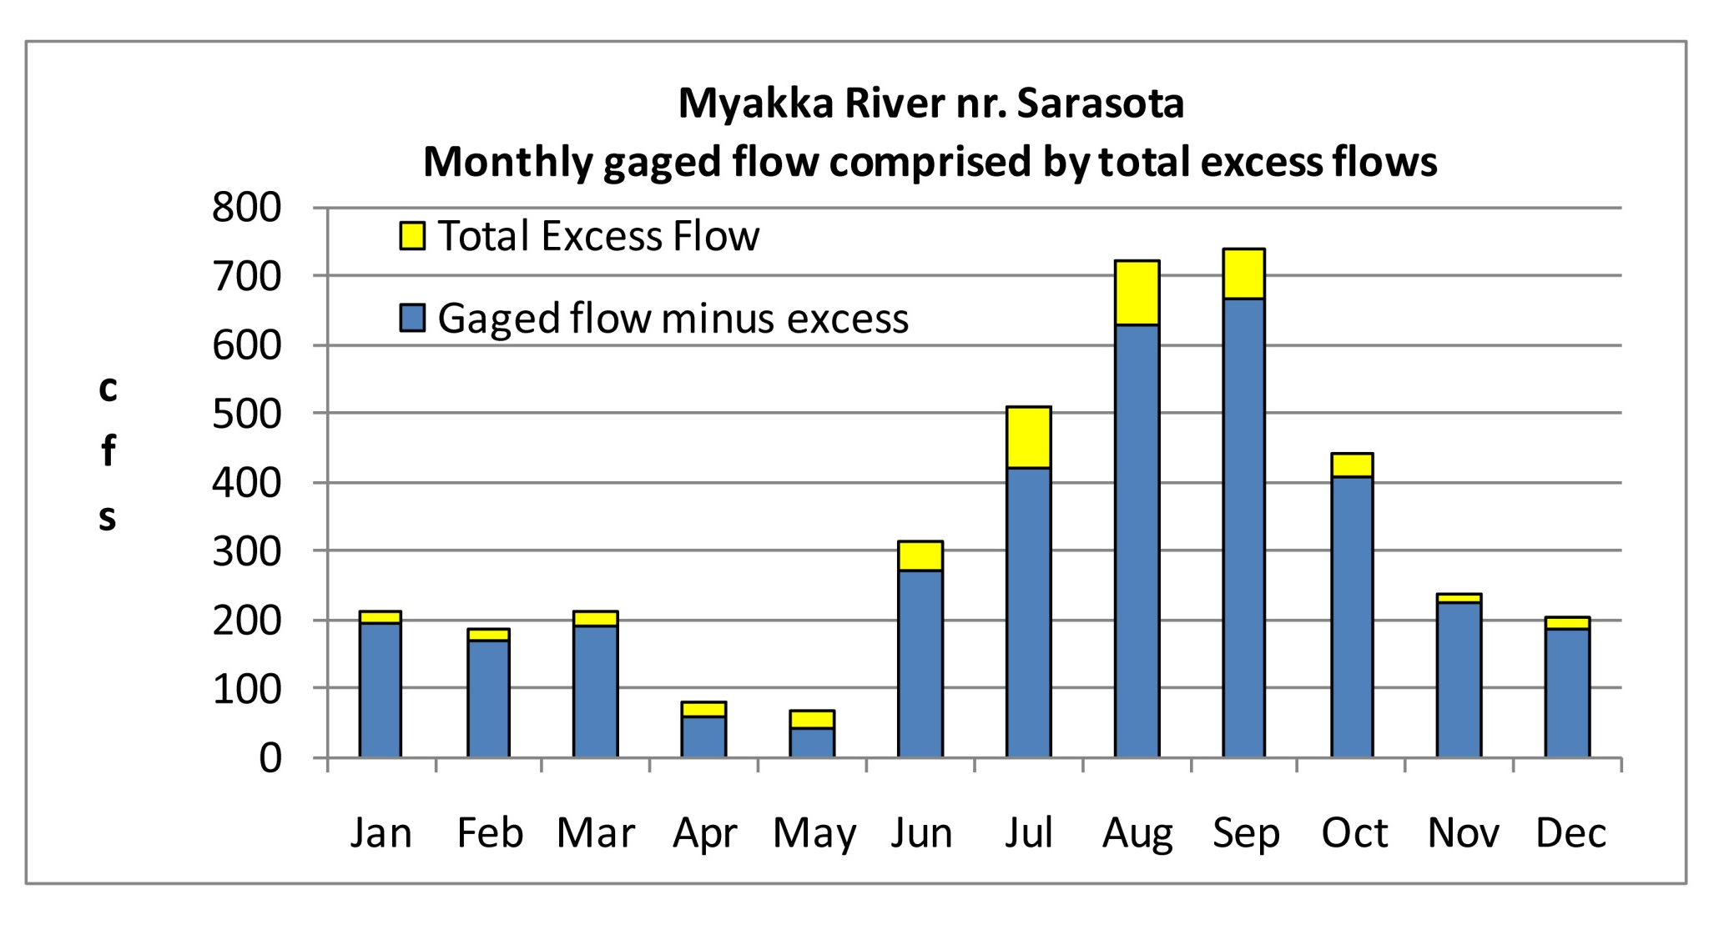
Excess flows in Upper River sub-basin predicted by detailed hydrologic model

Slide 14
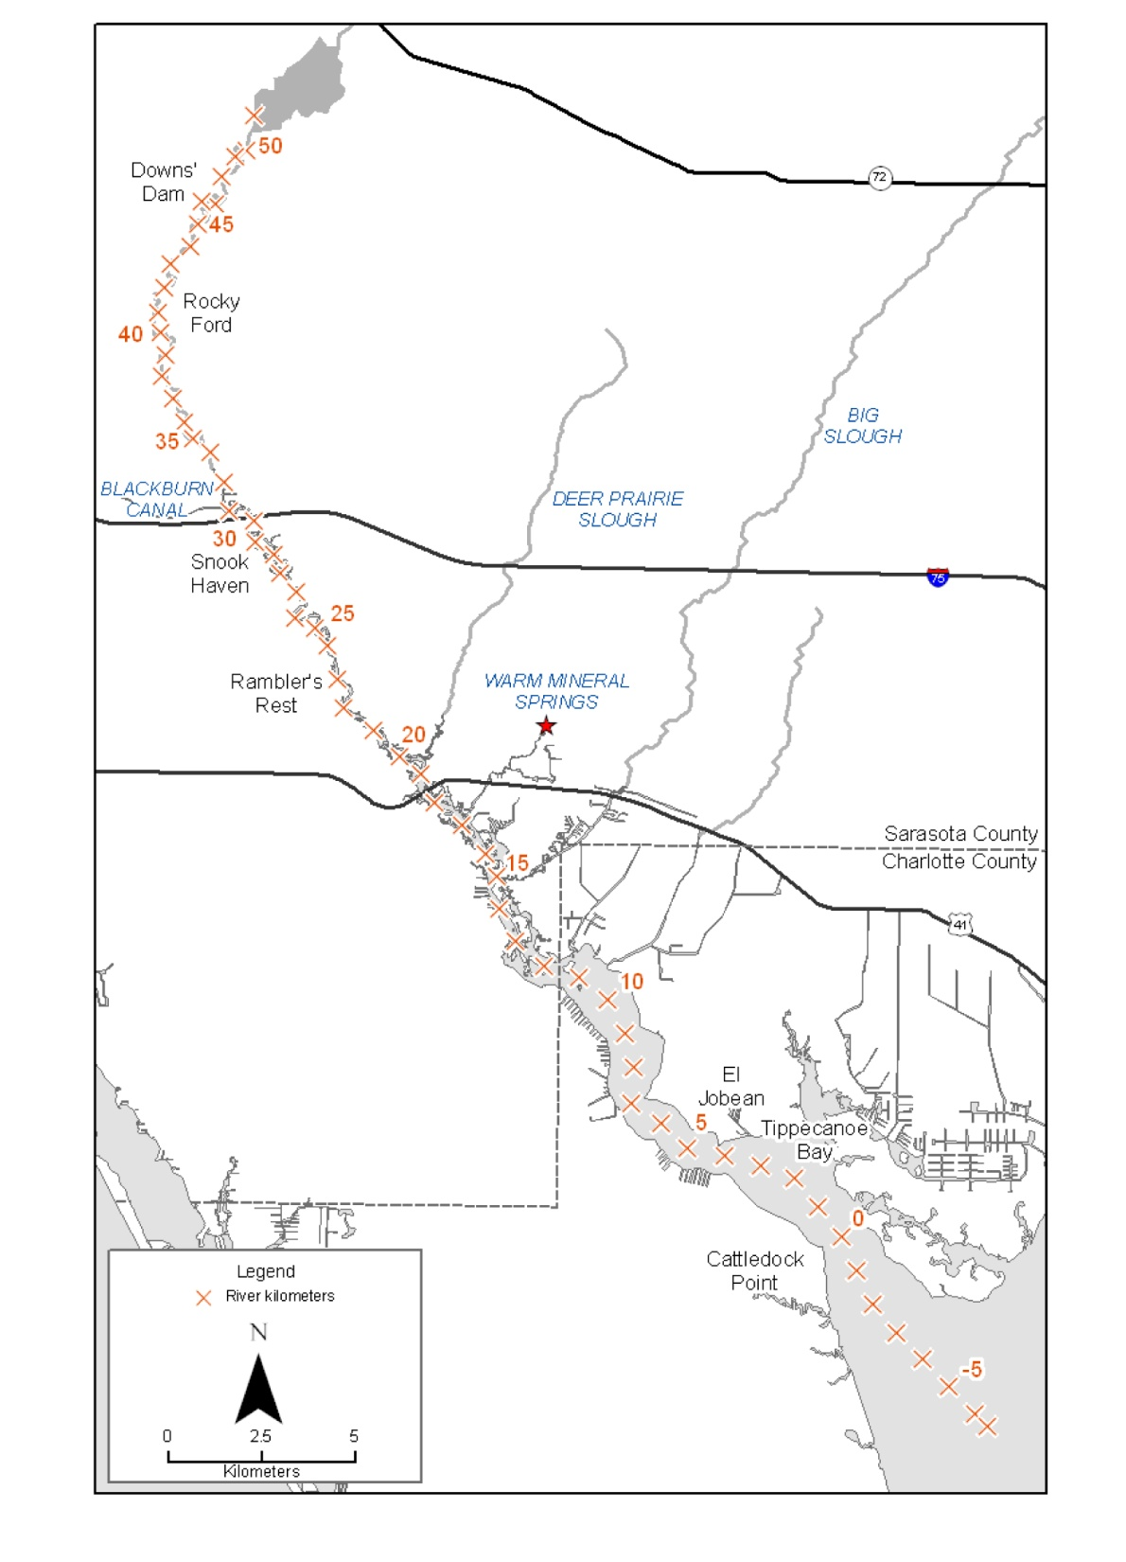

Slide 15
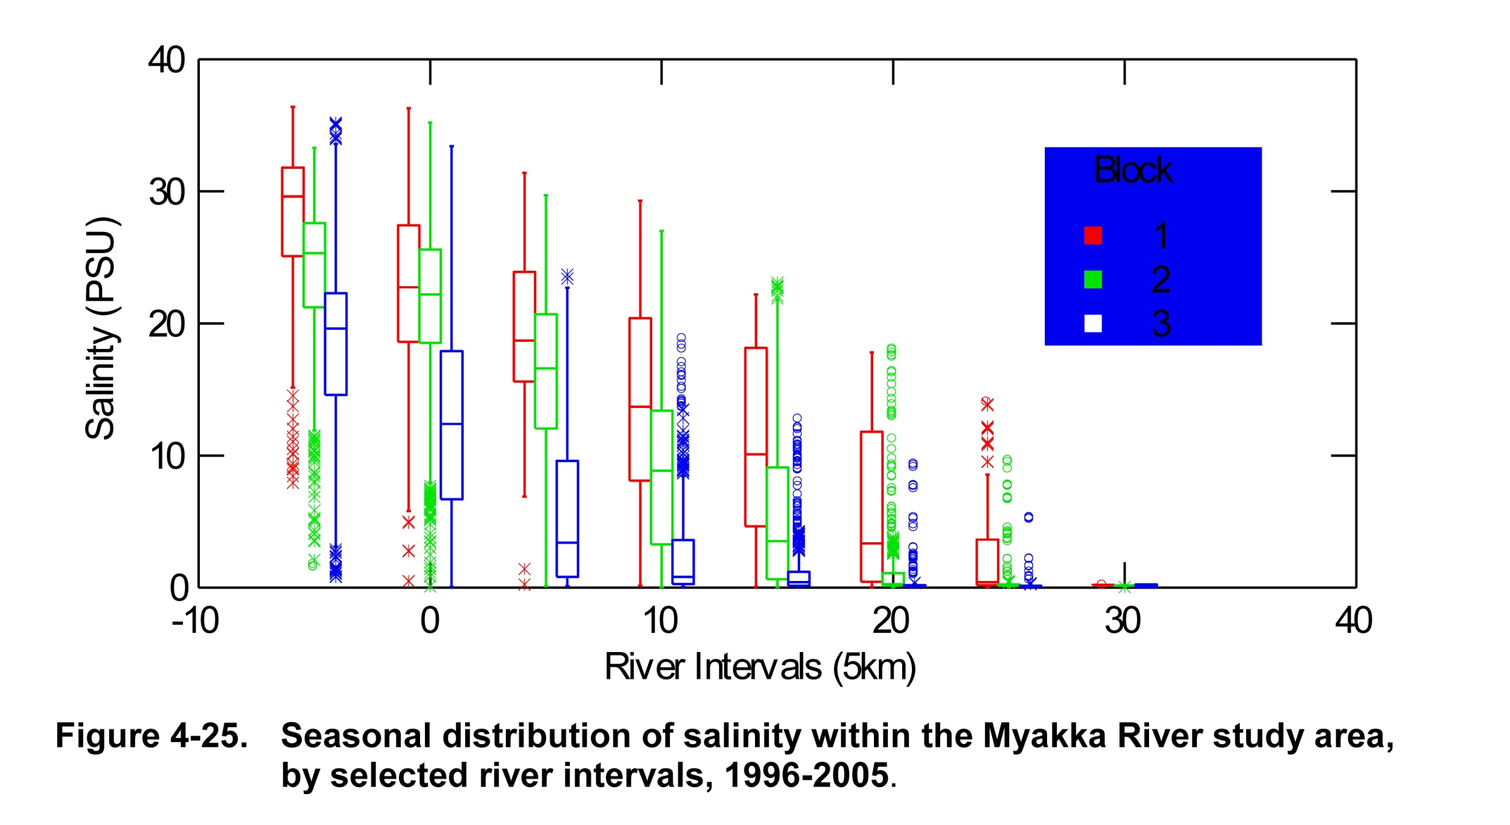

Slide 16
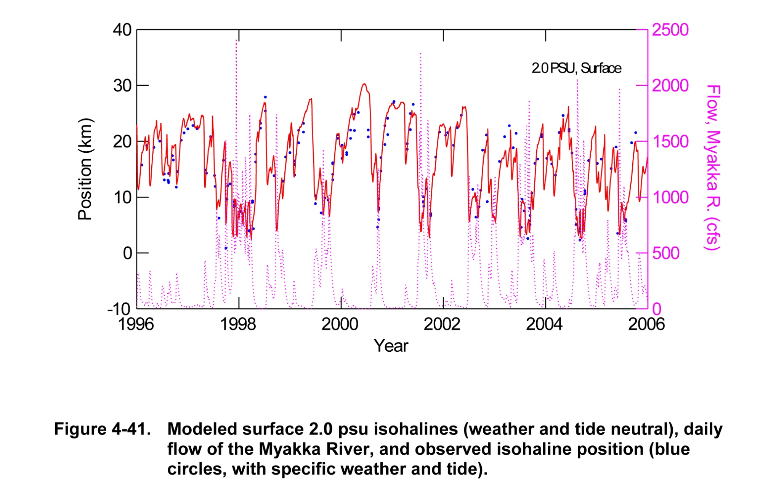

Slide 17
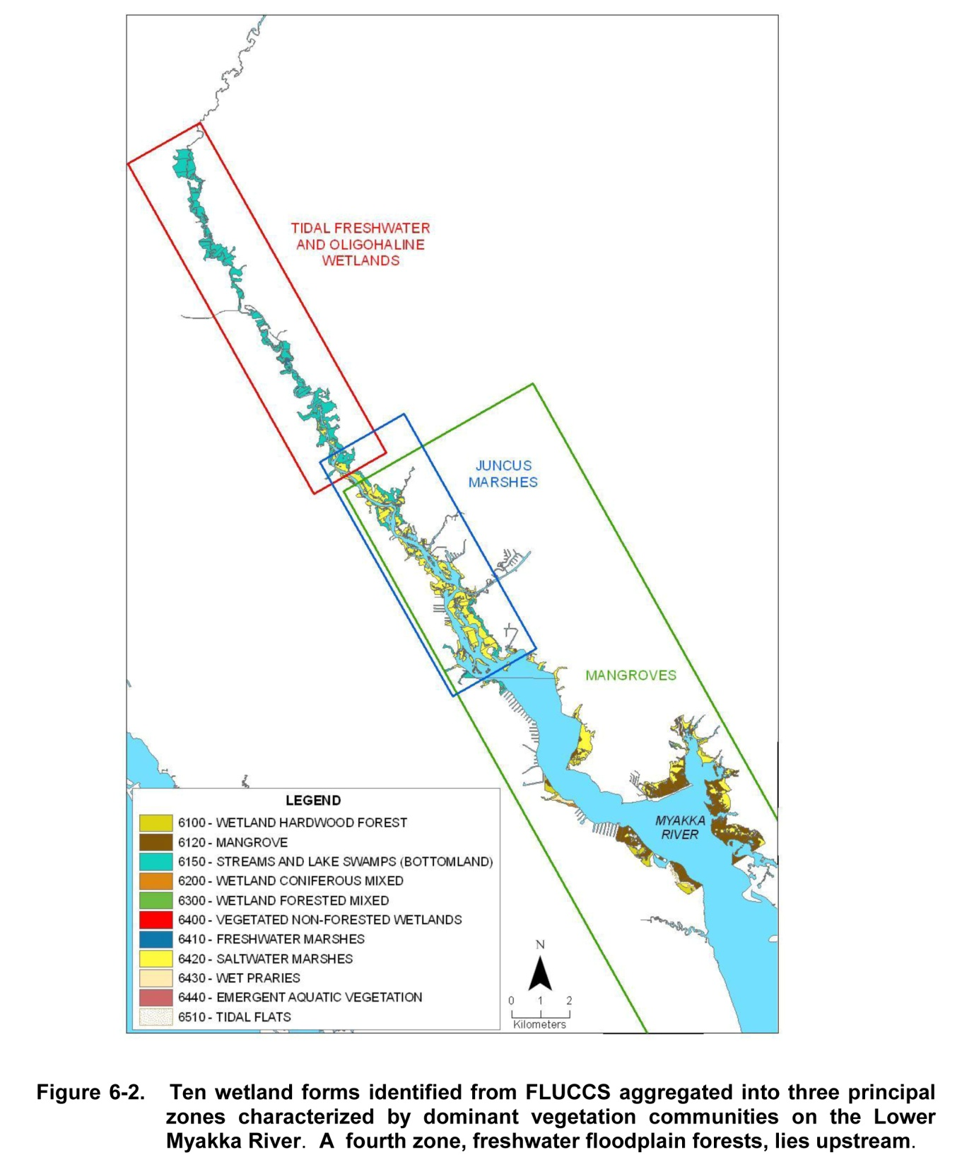

Slide 18
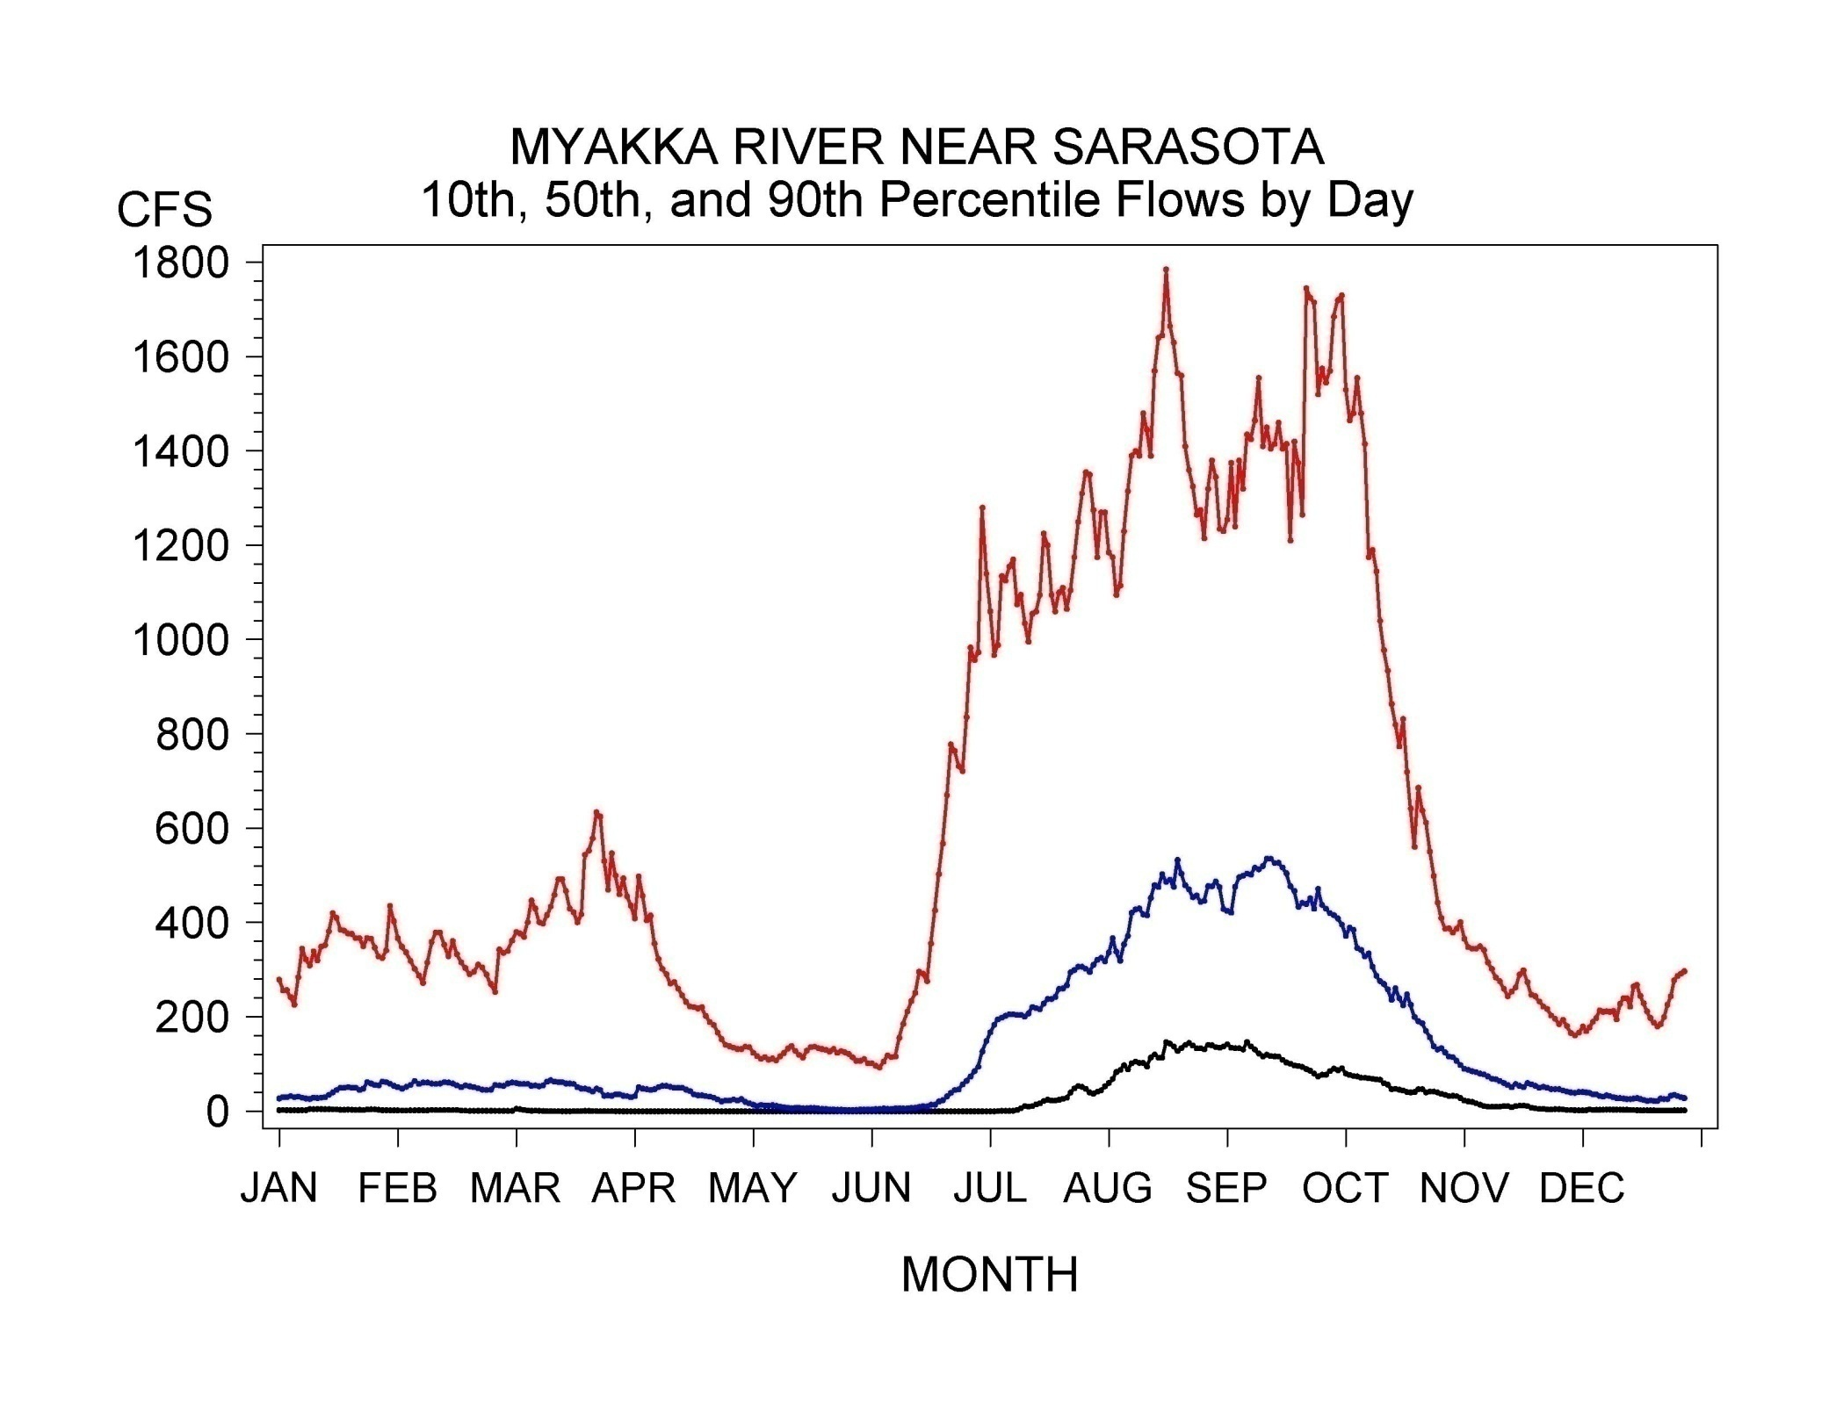
90th Percentile
50th Percentile
10th Percentile
winter
spring
summer
fall
Notes:
Figure 2-8. Time series plot of the 10th, 50th, and 90th percentile flows calculated for each day of the year for the Myakka River near the Sarasota gage. (centered – regular)

Slide 19
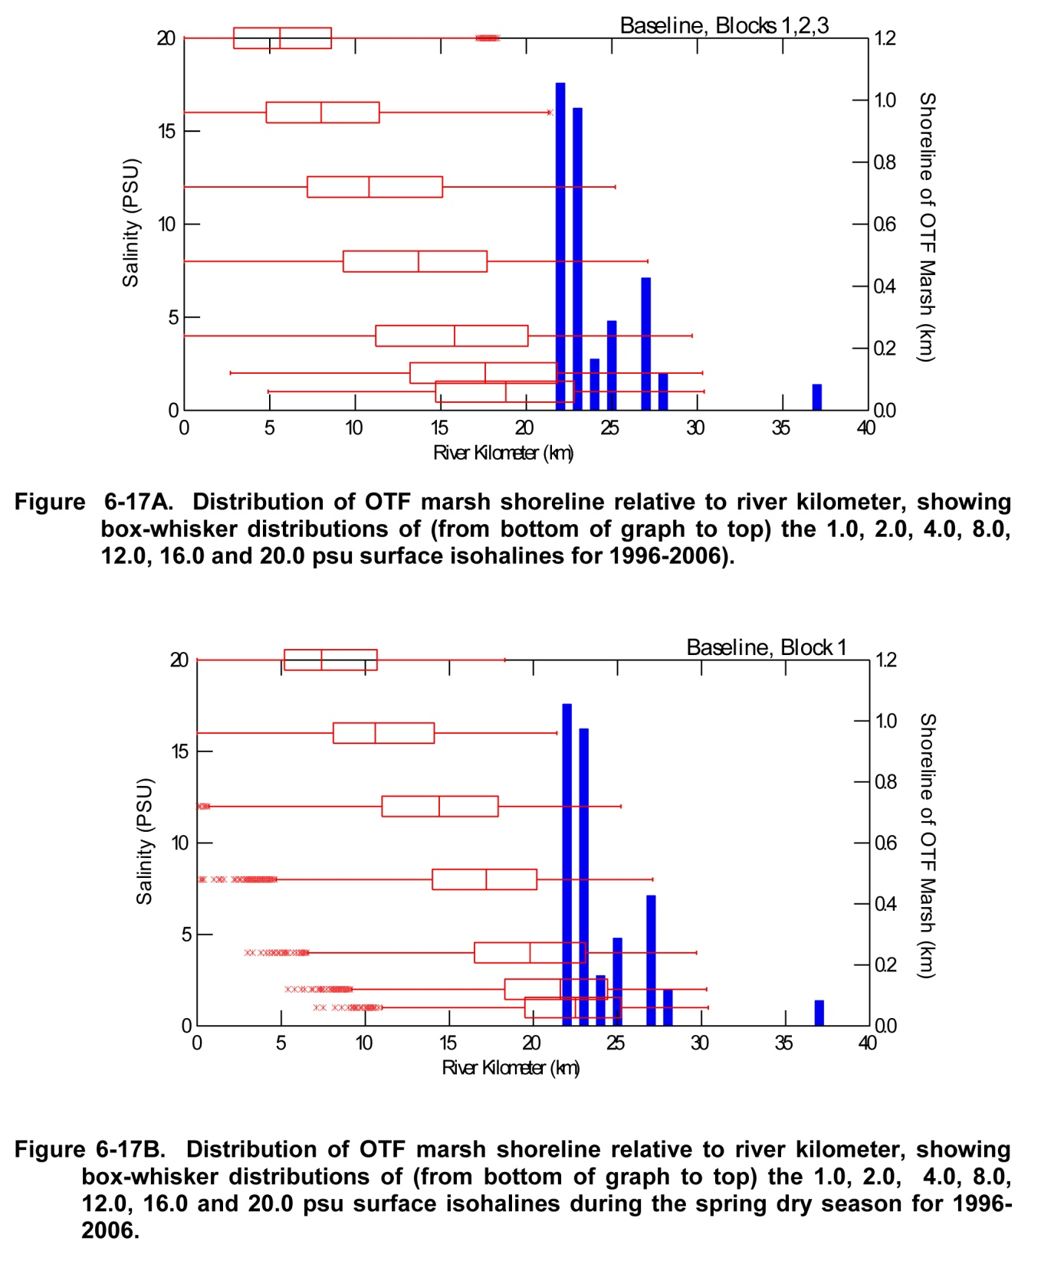

Slide 20
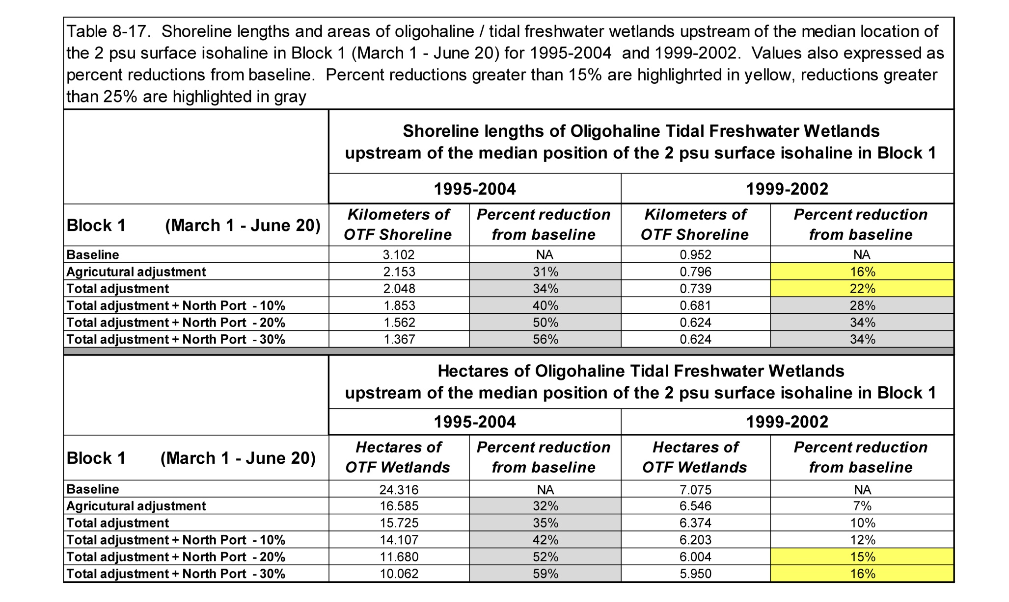

Slide 22
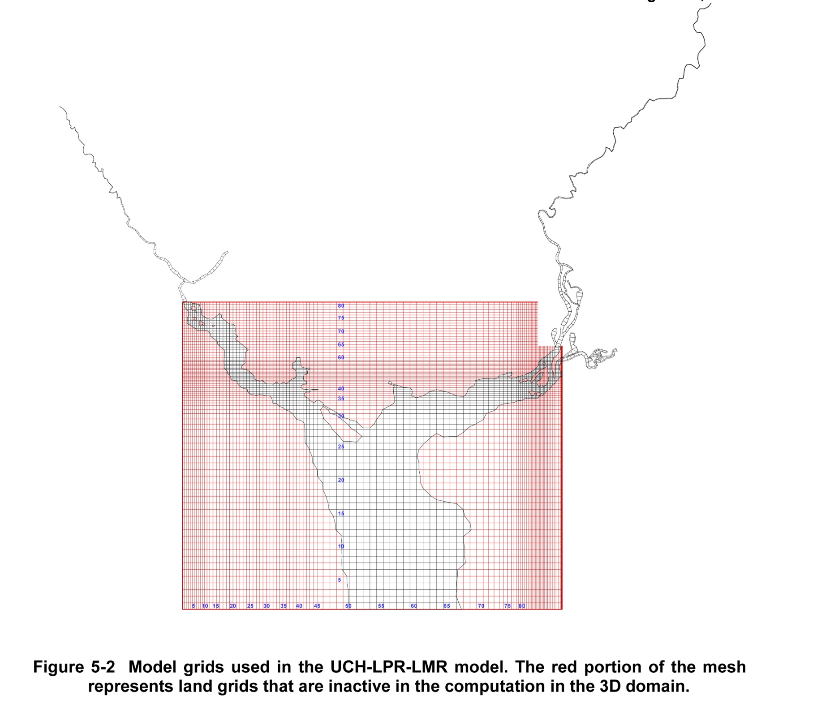

Slide 23
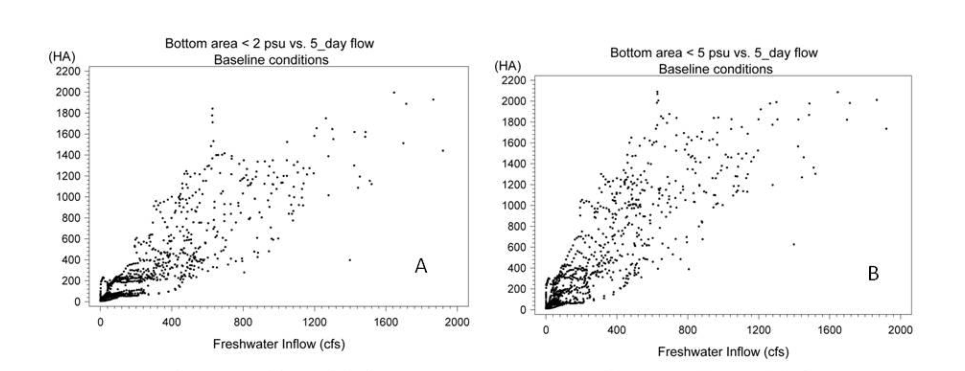

Slide 24
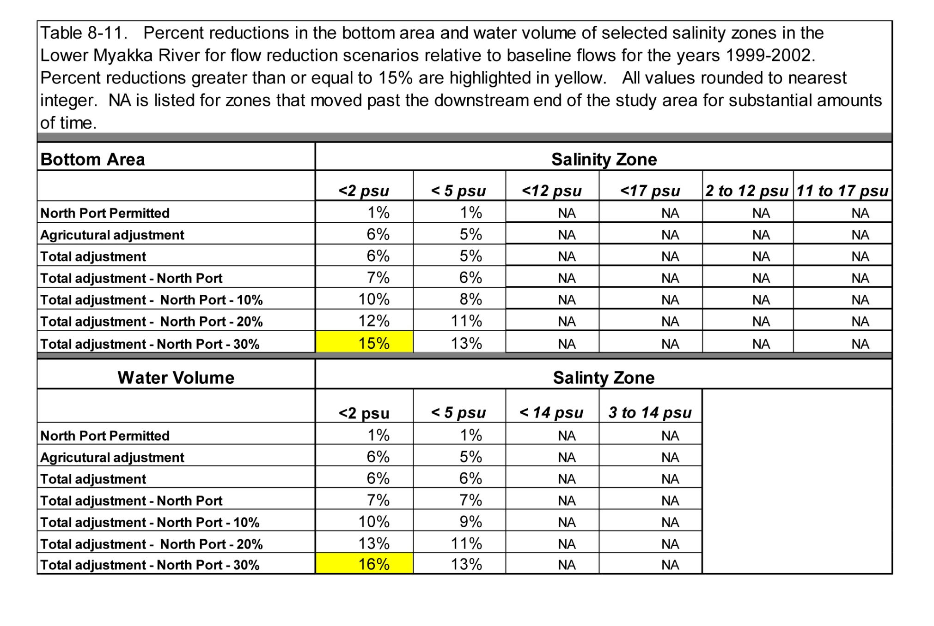

Slide 25
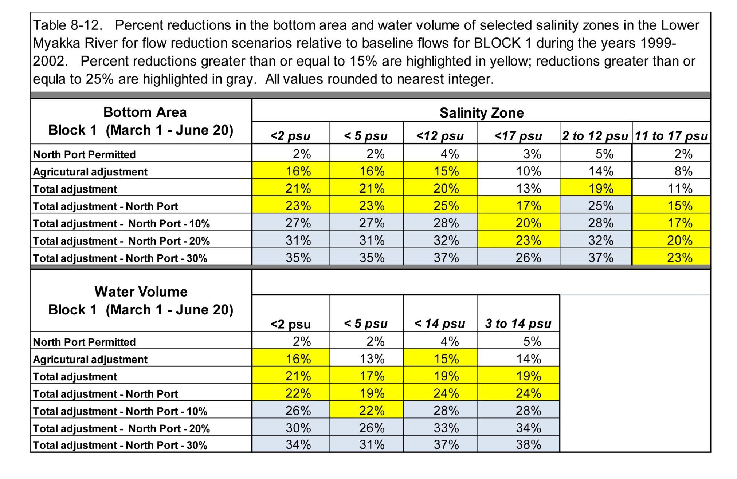

Slide 26
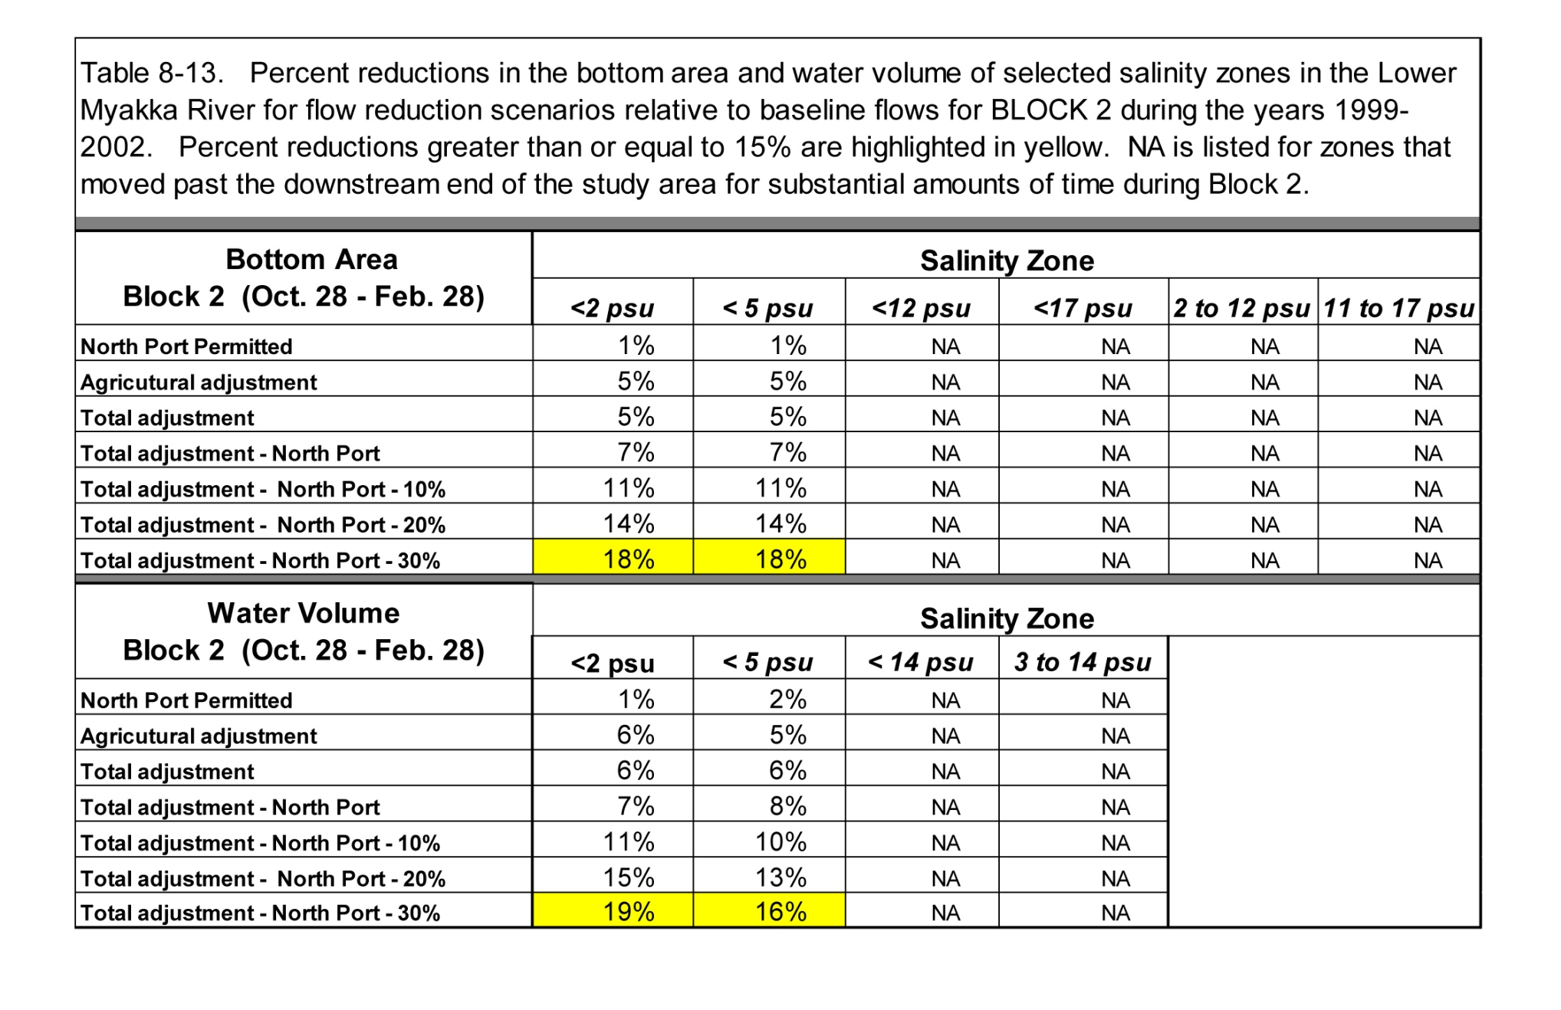

Slide 27
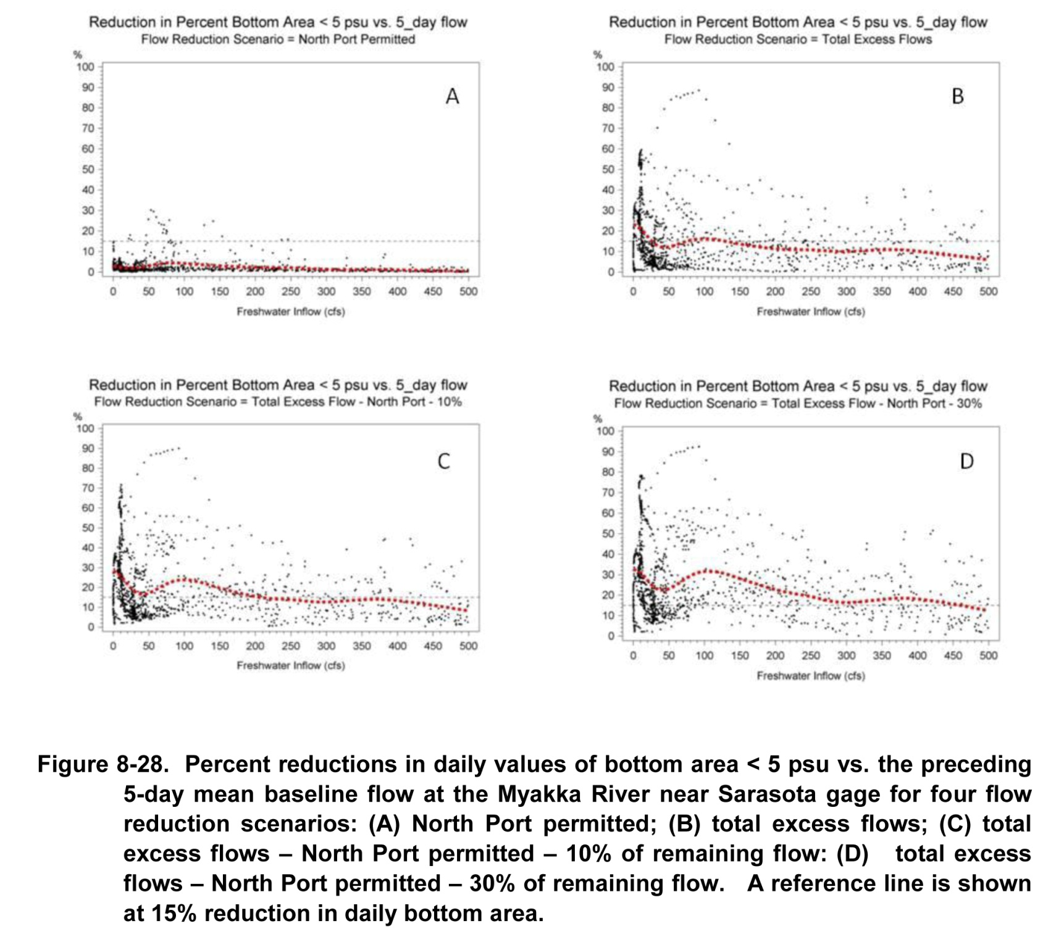

Slide 28
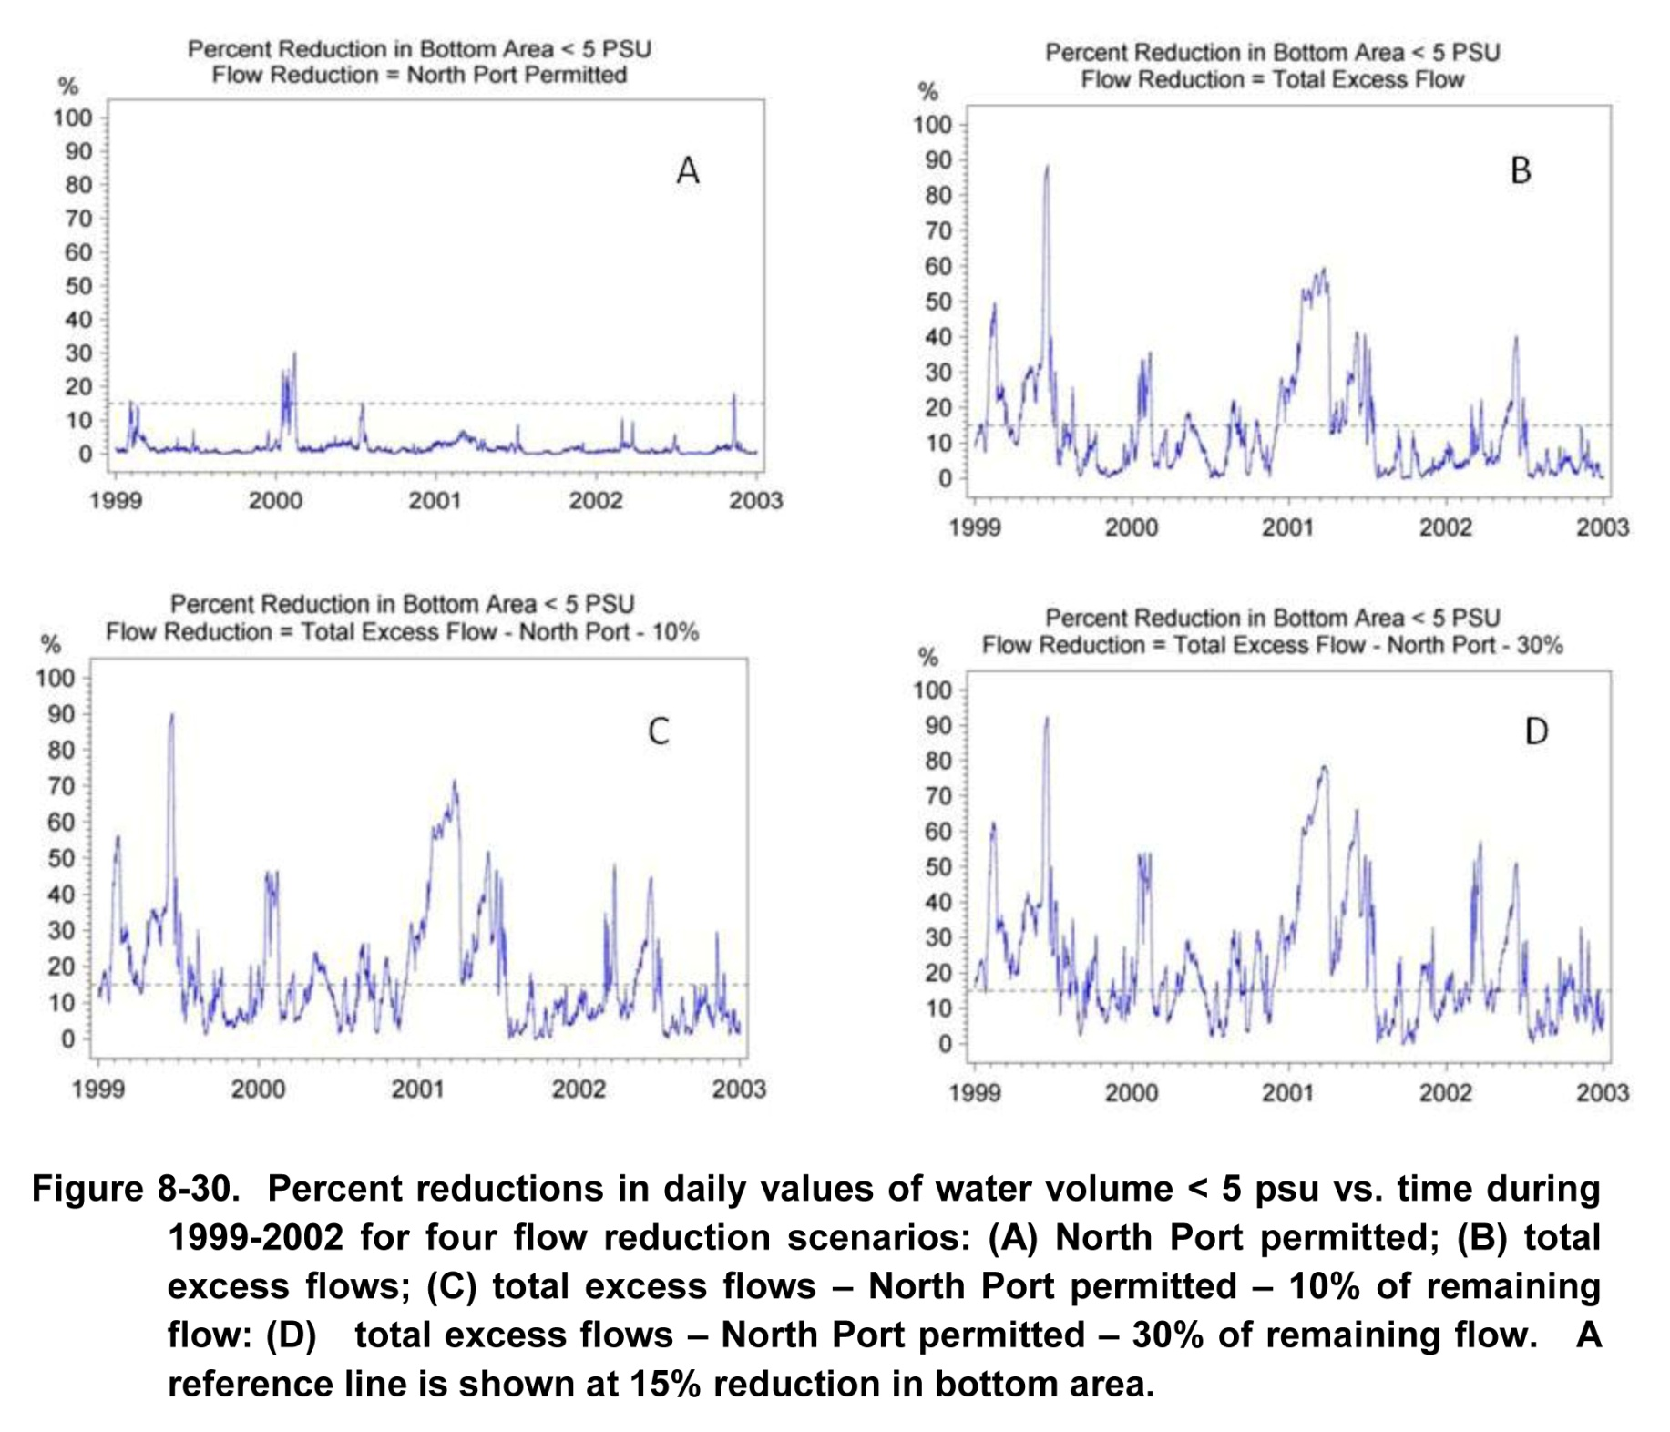

Slide 29
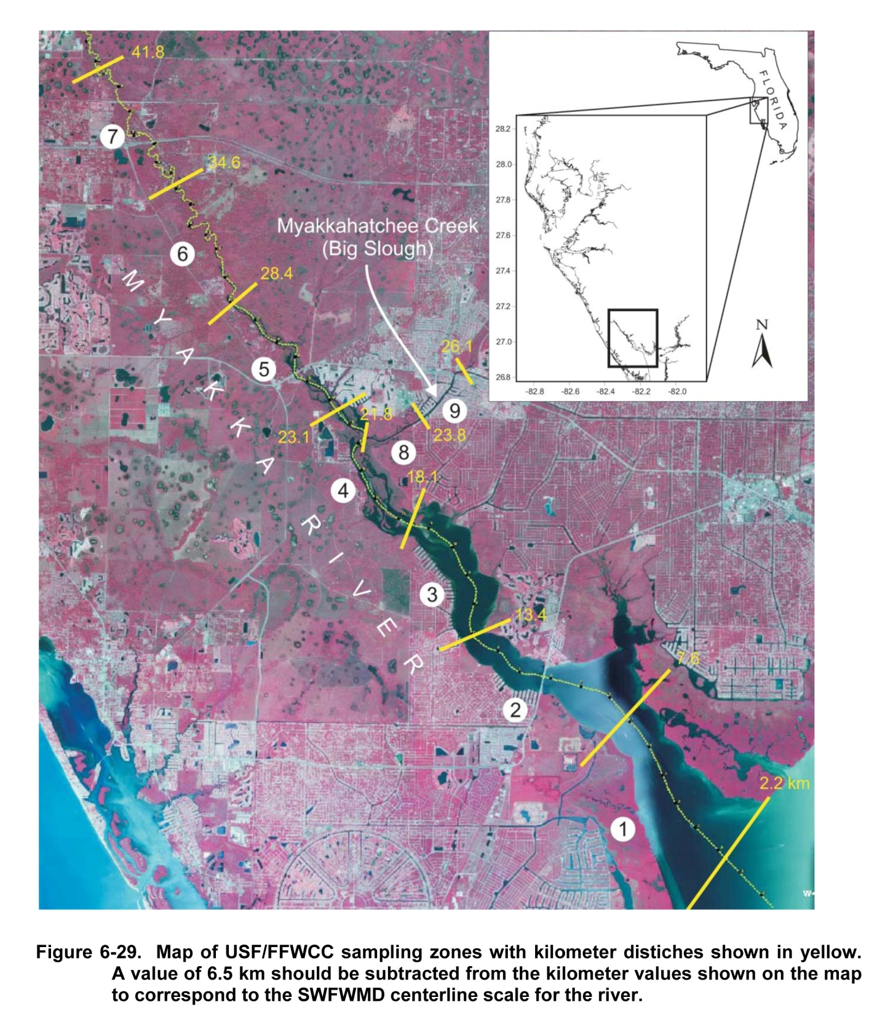
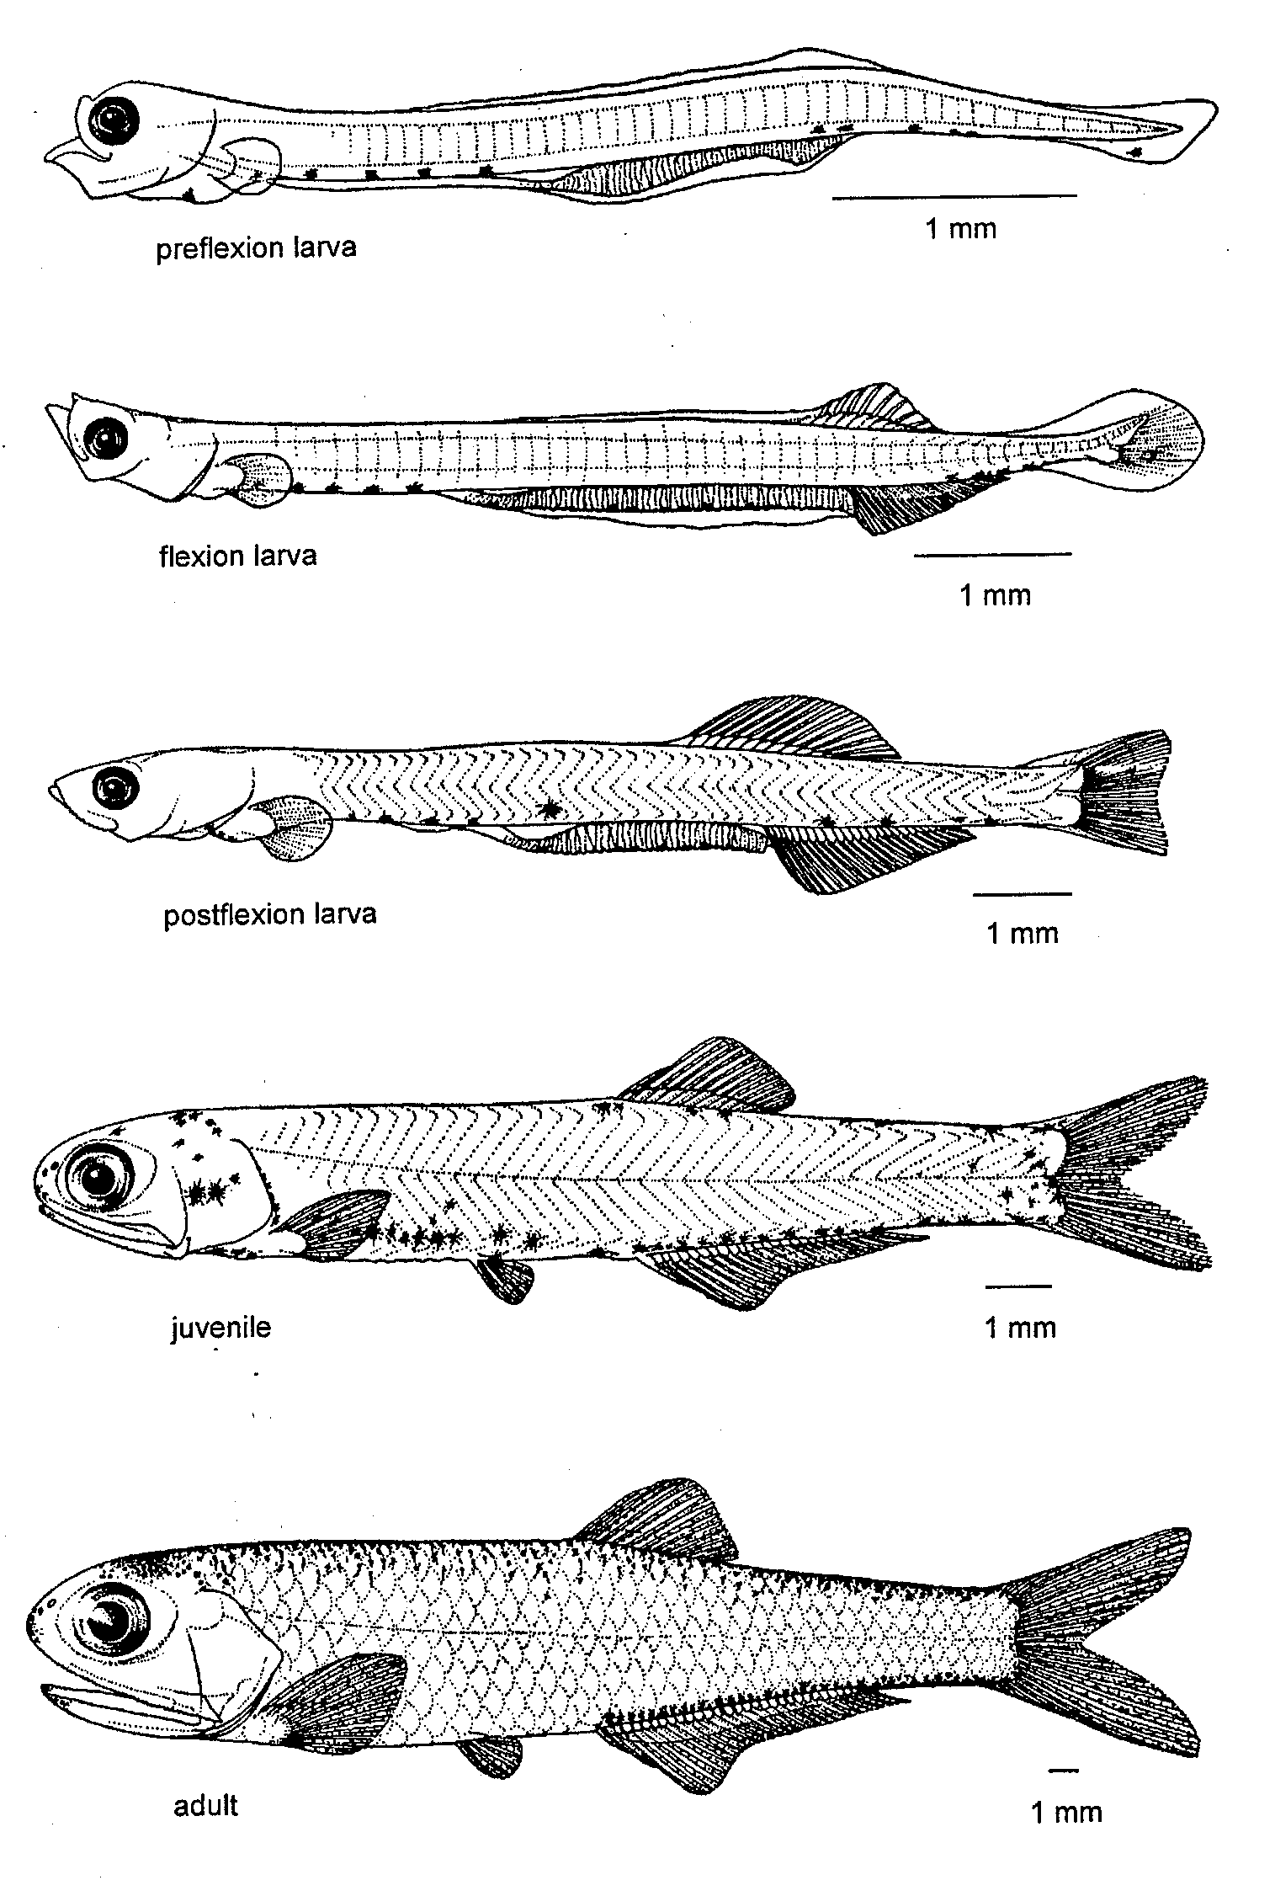

Slide 30
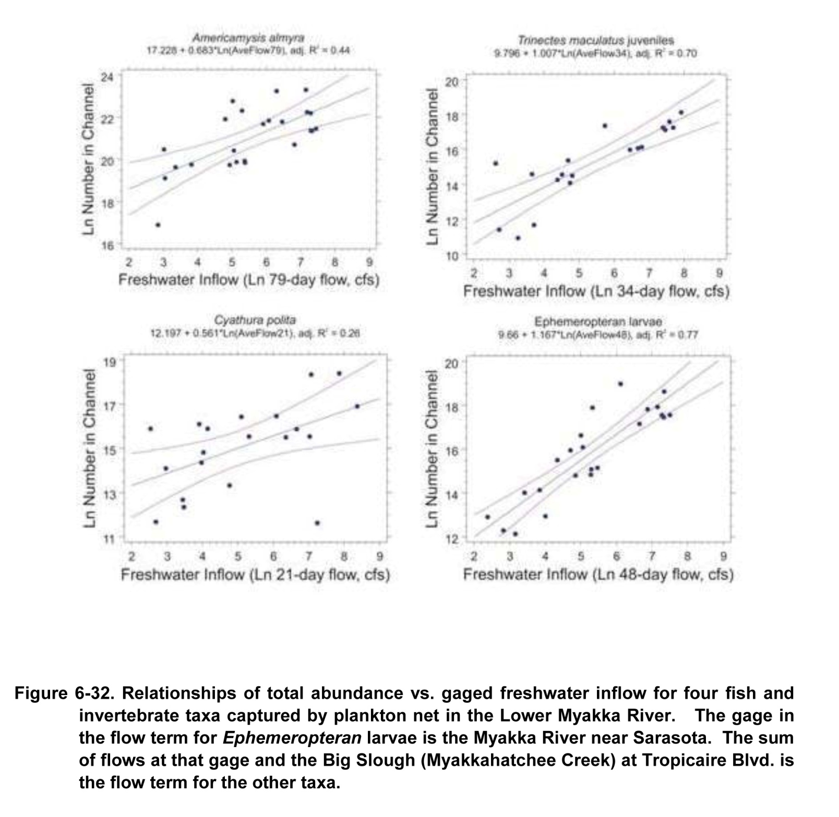

Slide 31
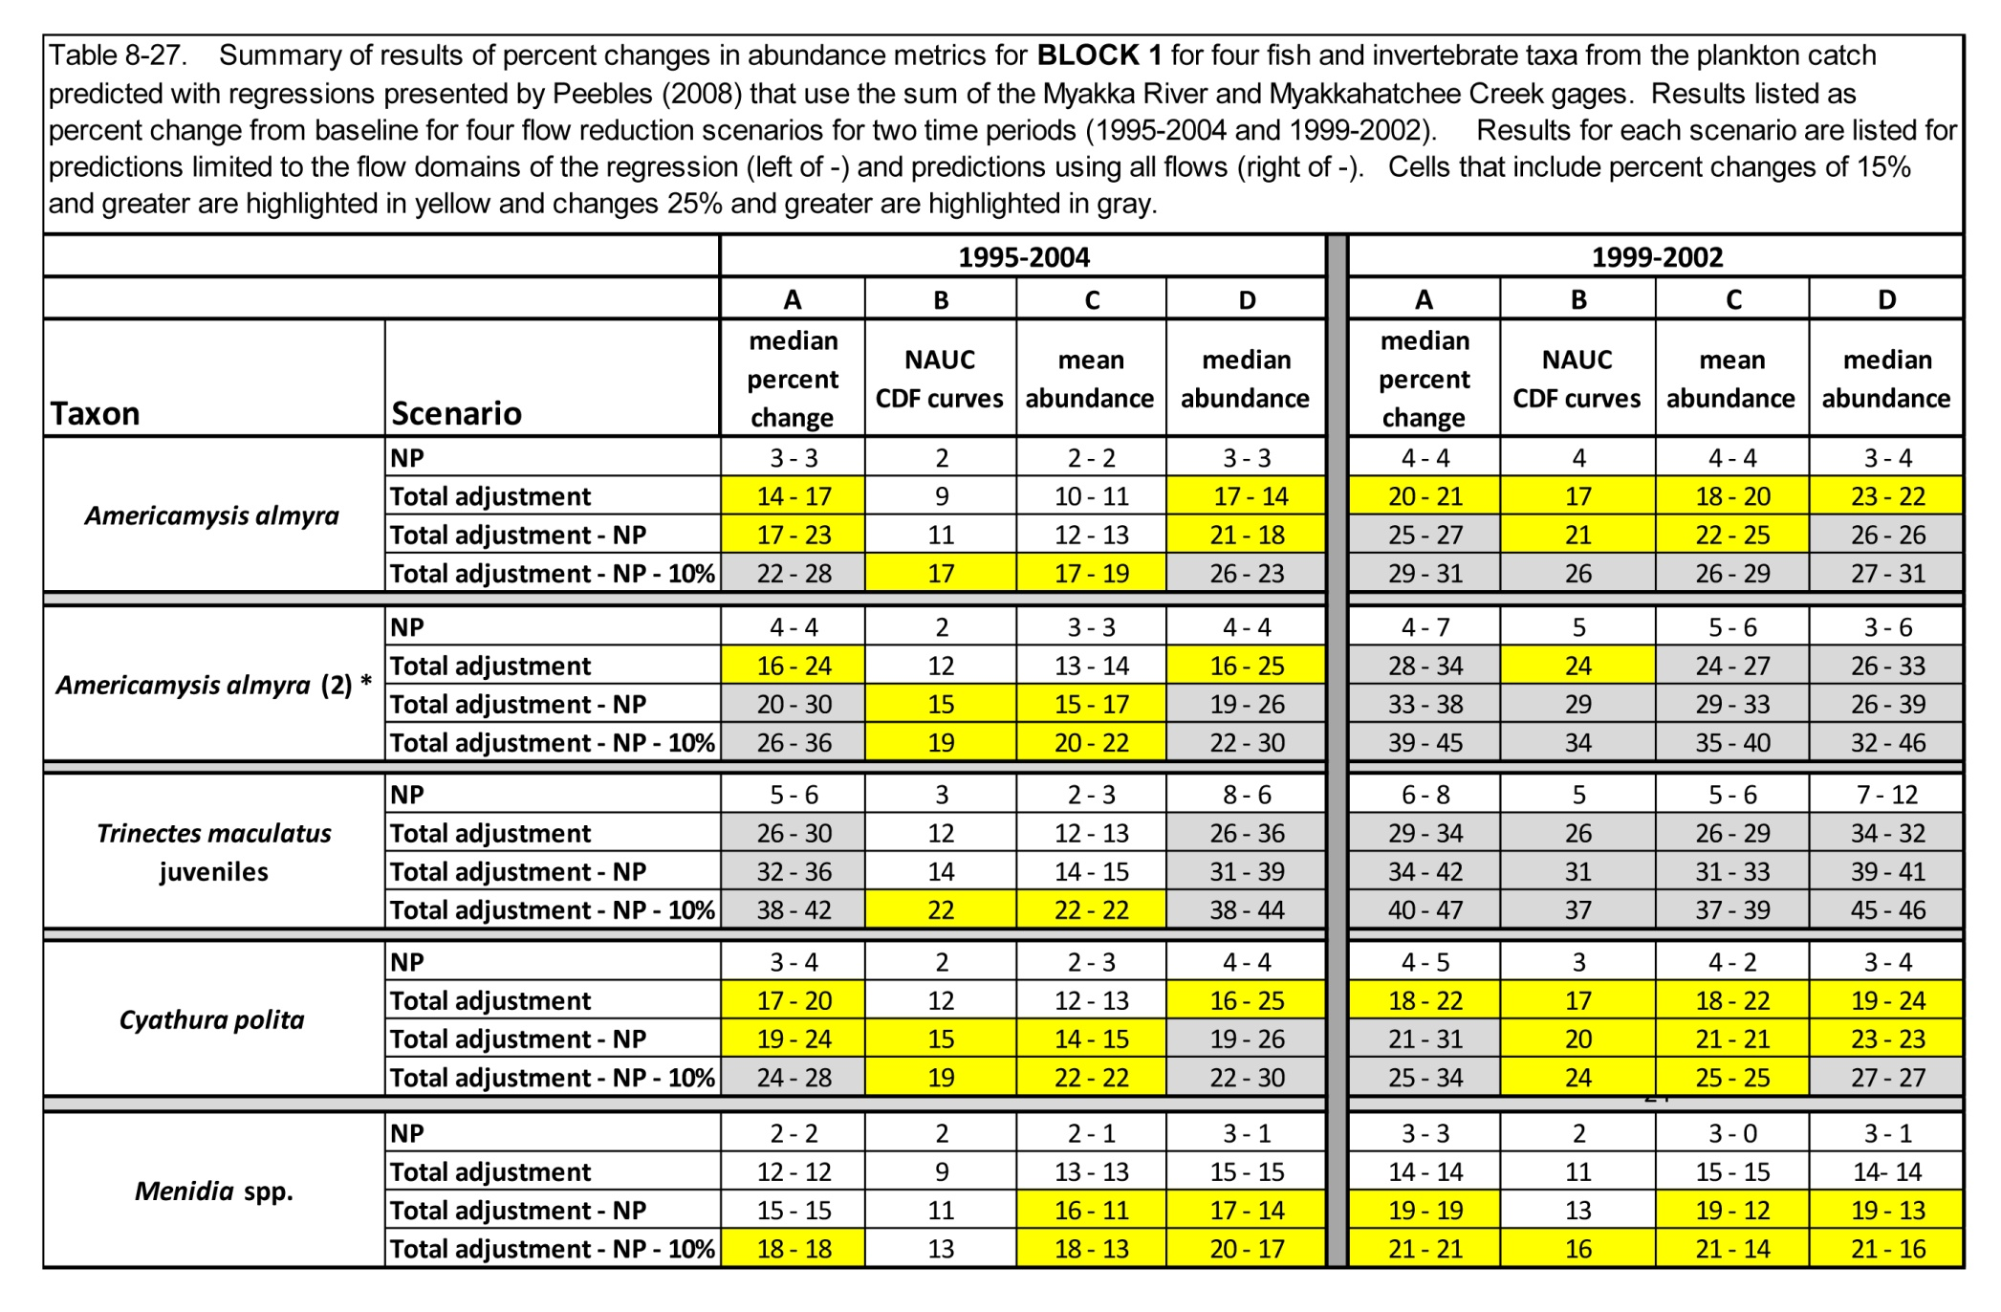

Slide 32
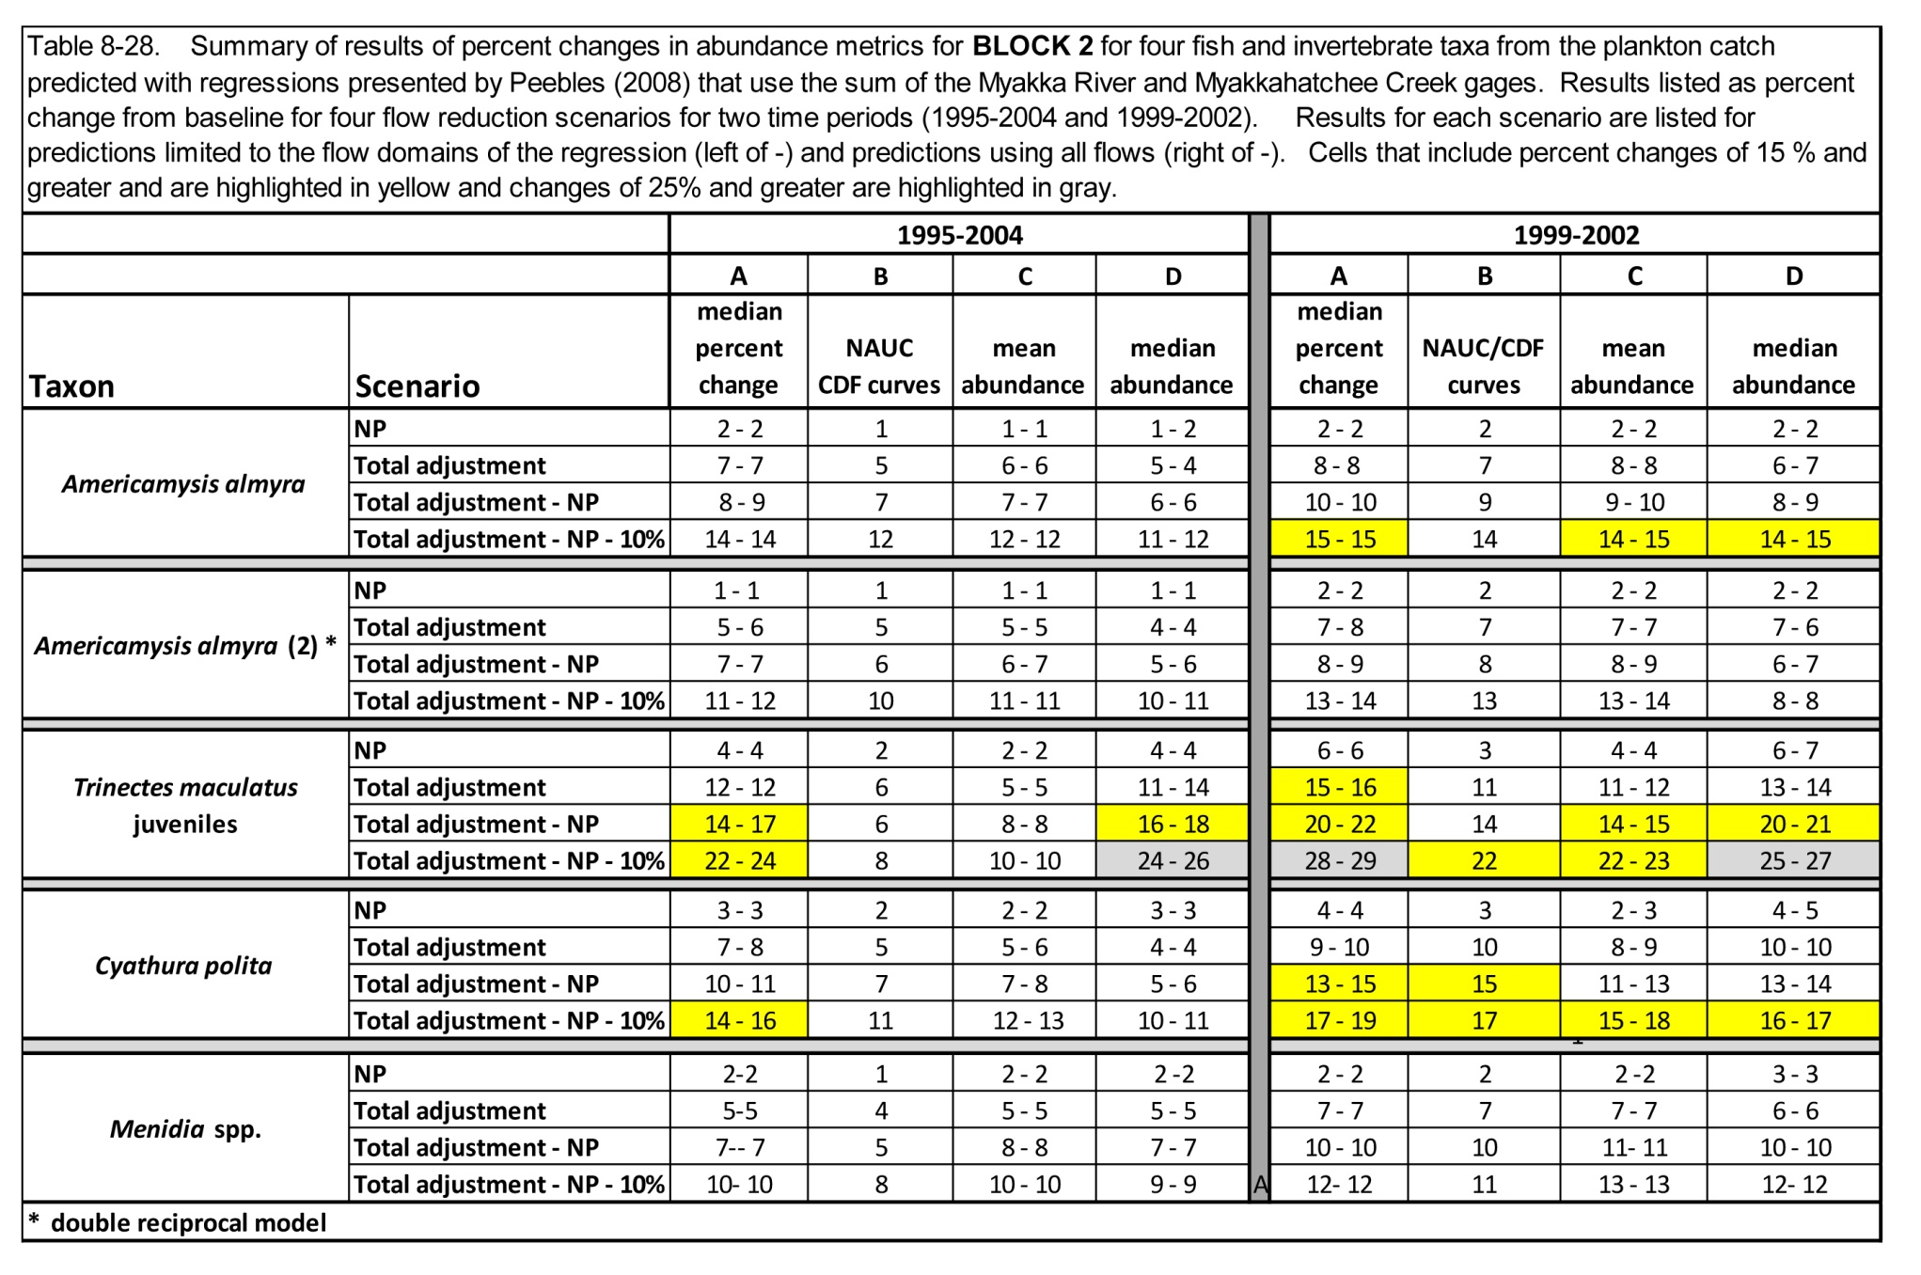

Slide 33
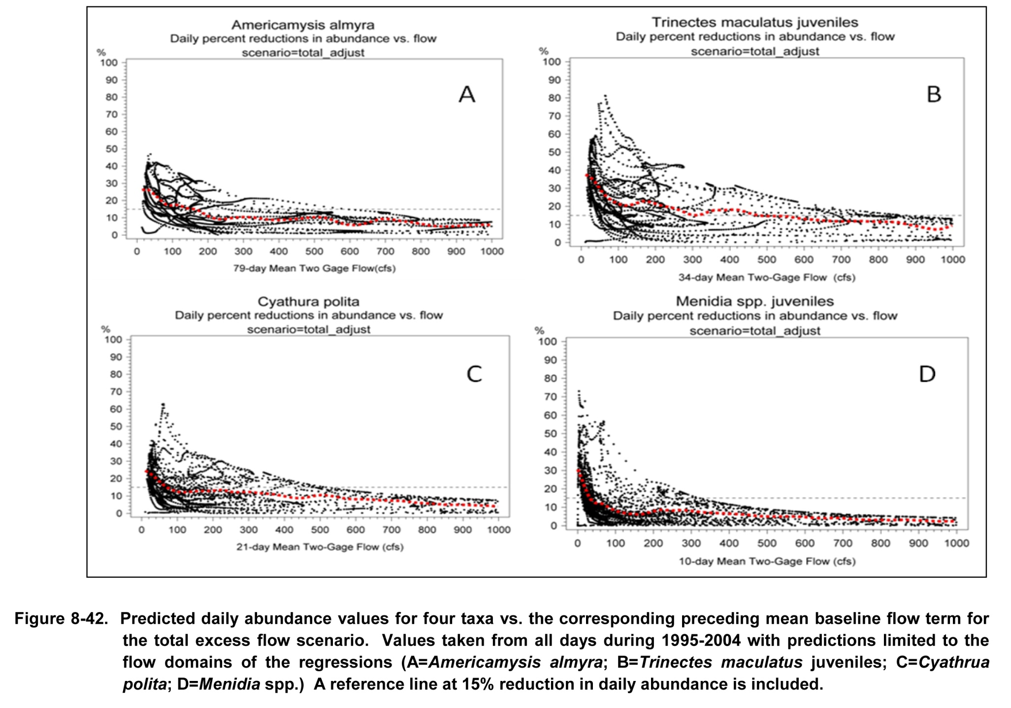

Slide 34
Lower Myakka River Proposed Minimum Flow Rule
Withdrawals limited to excess flow (up to 130 cfs) in upper river sub-basin when flows at the Myakka River near Sarasota gage are less than 400 cfs
Withdrawals include excess flow plus 10% of remaining flow at gage when gaged flows exceed 400 cfs
Minimum flows for Myakkahatchee Creek adopted within five years
Notes:
You could take out the bullet for Myakkahatchee Creek – is related to third slide

Slide 35
Lower Myakka River Adaptive management options
The simultaneous implementation of the Upper Myakka River Basin Initiative and the Lower Myakka minimum flows will require hydrologic monitoring and adaptive management
Evaluate strategies to replace lost flows to the Lower River resulting from removal of excess flows
Notes:
You could take out the bullet for Myakkahatchee Creek – is related to third slide

Slide 36
